Slide 1
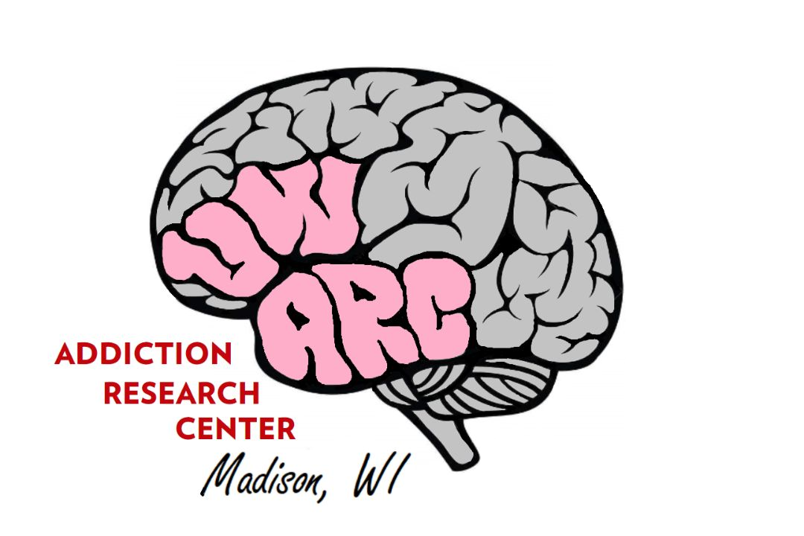
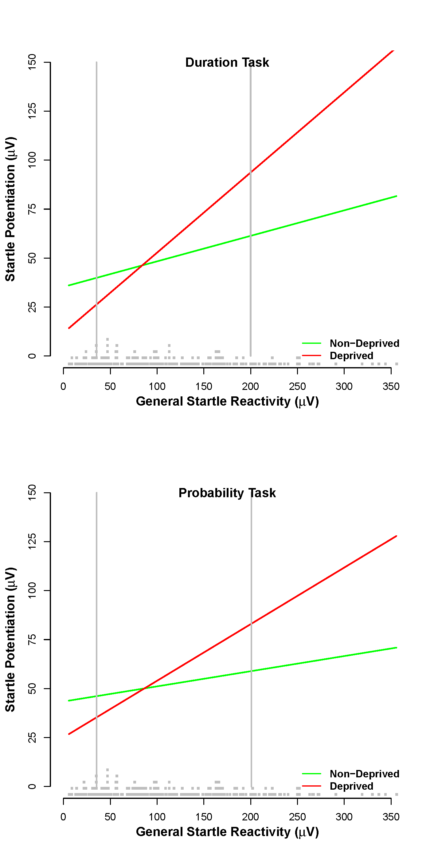
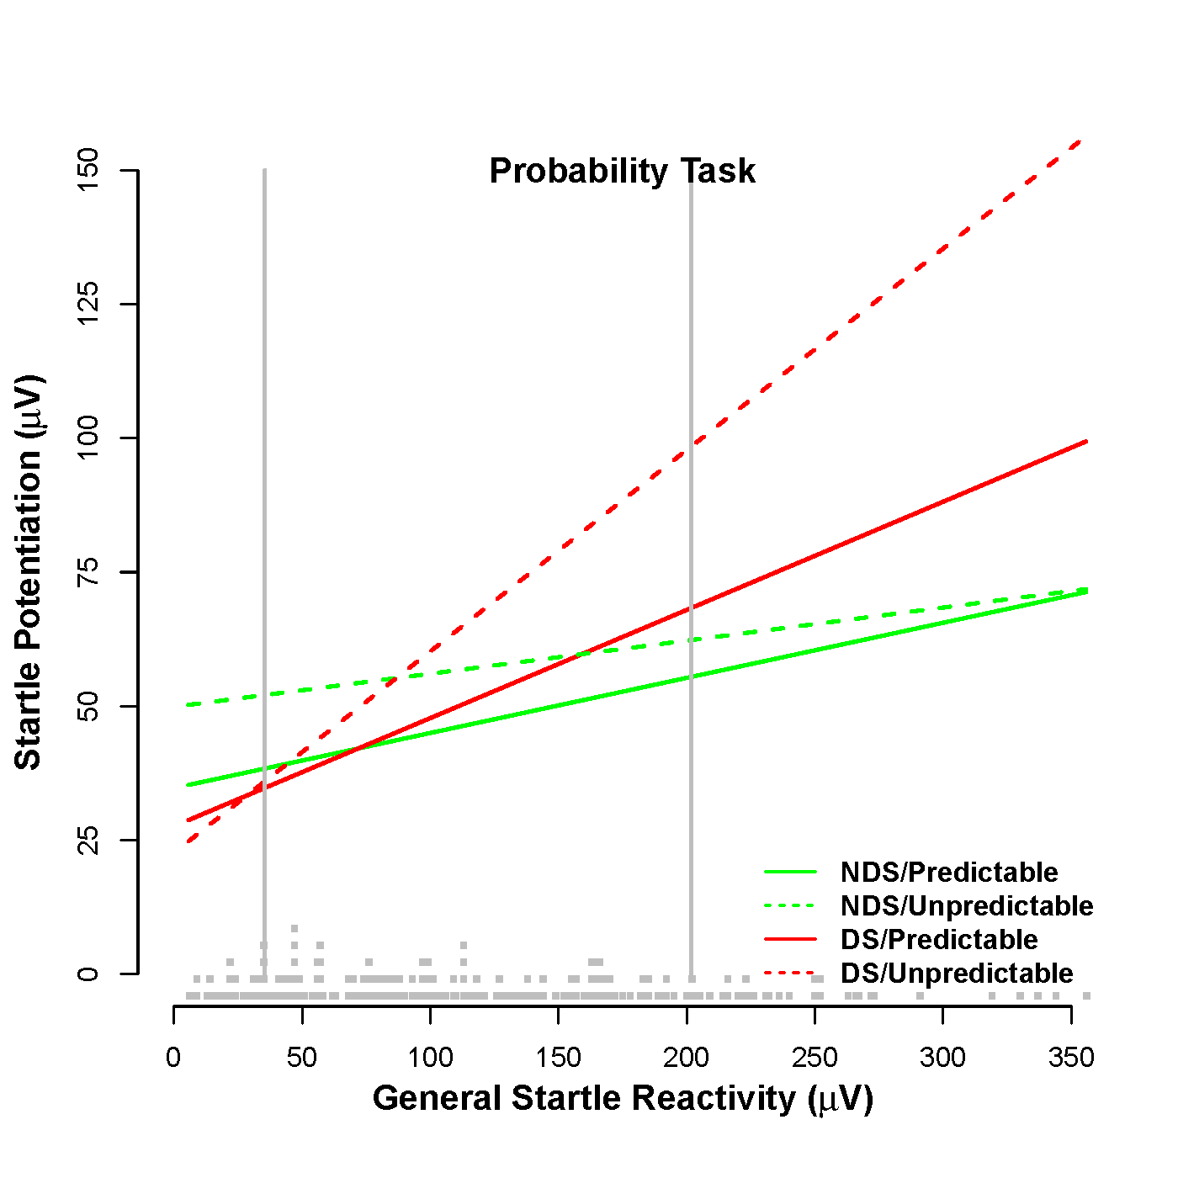
STRESS NEUROADAPTATIONS FOLLOWING HEAVY MARIJUANA USE: PHENOMENOLOGY AND INDIVIDUAL DIFFERENCES RISK
Gaylen E. Fronk, Rebecca Gloria, Kathryn Hefner, & John J. Curtin
University of Wisconsin-Madison
ABSTRACT
Both preclinical and clinical research with alcohol and other drugs implicate stress neuroadaptations following chronic use as a key etiologic process in addiction. Recent theory and research suggest these stress neuroadaptations may manifest more strongly during unpredictable threats. Emerging evidence also suggests that high general startle reactivity may represent a risk factor for these neuroadaptations. In this study, we evaluated these stress neuroadaptation theses with respect to heavy marijuana use. We measured startle potentiation to index stressor reactivity to unpredictable and predictable threats in two groups of heavy marijuana users (randomly assigned to deprived and non-deprived smoker conditions) and non-smokers. This allowed us to test for Deprivation (deprived vs. non-deprived) and Heavy smoker (all heavy smokers vs. non-smokers) effects. We used two previously validated tasks with different manipulations of threat predictability to assess replicability/robustness. We observed a General Startle Reactivity X Deprivation interaction in both tasks such that deprivation increased startle potentiation among marijuana smokers with high general startle reactivity. This interaction was stronger for unpredictable threats in the task that involved probabilistic uncertainty. These results suggest that heavy marijuana use may produce stress neuroadaptation(s) that manifest selectively when smokers stop their use. High general startle reactivity may represent a risk factor for this possible etiologic process.
BACKGROUND
Stress neuroadaptations emerge as a result of chronic or heavy use of alcohol or other drugs and manifest as increased reactivity to stressors
This increased stress reactivity may be observable in all heavy users or only during periods of deprivation
This theoretical model has been developed from rodent work; our lab has suggested a clarification that increased stress reactivity may be observable during unpredictable stressors selectively
We know that, despite considerable exposure to alcohol and other drugs, only a subset of heavy users progress to a substance use disorder, suggesting the role of individual difference in risk
Purpose: 1) Measure stress reactivity in heavy marijuana users (vs. non-users) and in deprived (vs. non-deprived) users across stressor type, and 2) Examine if general startle reactivity represents an individual difference risk factor for stressor reactivity
INDEPENDENT VARIABLES
Heavy marijuana smokers (n = 134) vs. non-smokers (n = 76) [Total N = 210]
Smokers randomly assigned to deprived (n=68) vs. non-deprived (n = 66)
Individual differences in General Startle Reactivity
Predictable vs. unpredictable threat type
THREAT TASKS
Figure 1. Startle Potentiation Varies by Deprivation and GSR
Figure 2. Startle Potentiation Varies by Deprivation, GSR and Threat Type in the Probability Task
Table 1. Marijuana Deprivation Manipulation Checks
Table 2. Means and standard deviations for marijuana-related self-report measures, THC creatinine ratio at experimental visit (post-deprivation) and specimen ratio (comparison of THC creatinine ratios from screening and experimental visits). Deprivation effect represents comparison of deprived and non-deprived smokers.
 | Non-Deprived Smokers |  | Deprived Smokers |  | Deprivation Effect
 | Mean | SD | Mean | SD
Marijuana Withdrawal Checklist (Total) | 5.14 | 4.68 | 9.74 | 7.56 | p < .001
Marijuana Craving Questionnaire (Total) | 74.23 | 12.65 | 80.17 | 14.26 | p = 0.01
THC Creatinine Ratio (Experimental Visit) | 2.96 | 3.56 | 0.95 | 1.27 | p < .001
Specimen Ratio | 1.13 | 0.90 | 0.36 | 0.26 | p < .001
PREDICTABLE
UNPREDICTABLE
DURATION
5 s
5 s
20/50/80 s
SUMMARY & FUTURE DIRECTIONS
These findings provide evidence for stress neuroadaptations following heavy marijuana use. This study offers three important boundary conditions:
1) increased stress reactivity is only observable during periods of deprivation
2) the effects of deprivation are limited to individuals with high general startle reactivity
3) selective reactivity to unpredictable (vs. predictable) stressors arises when the probability (but not the duration) of the threats is uncertain
Given the inherently developmental nature of the stress neuroadaptation hypothesis, this research should ideally be conducted with longitudinal data. In the early stages of this research (i.e., the present study) we have used cross-sectional data; however, future research should seek to replicate and extend these findings longitudinally.
Future work should be conducted in clinical samples to assess the utility of these findings for symptom severity, individual differences risk, and potential treatment targets.
PREDICTABLE
UNPREDICTABLE
PROBABILITY
5 s
5 s
5 s
5 s

