Slide 1
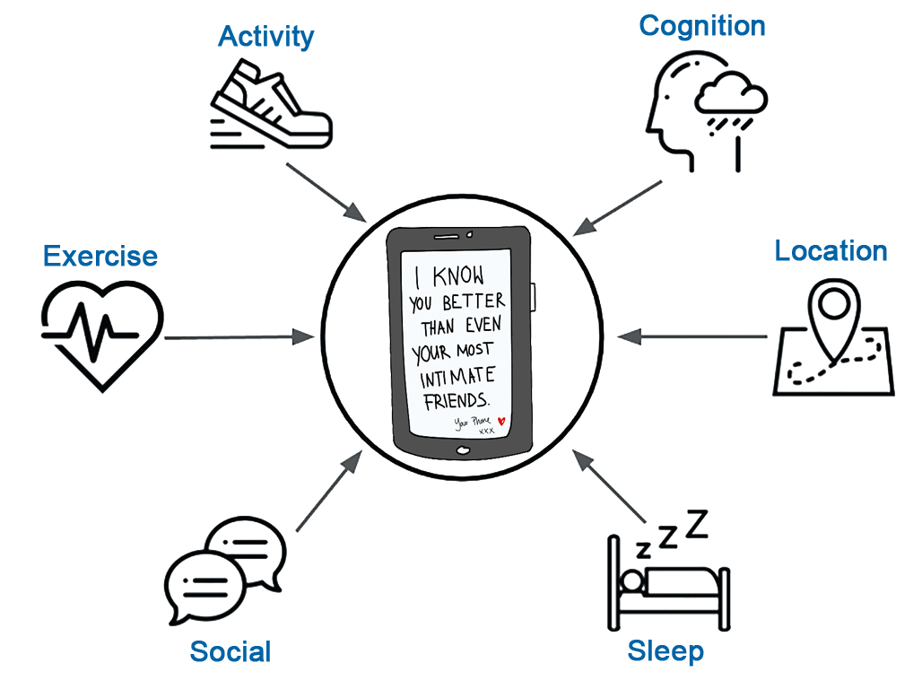
Personal Sensing for Temporally Precise
Lapse Risk Prediction for Alcohol Use Disorder
John J. Curtin, Kendra Wyant, Sarah Sant’ana, & Susan Wanta
University of Wisconsin - Madison
jjcurtin@wisc.edu

Slide 2
Mental Healthcare Needs are High and Unmet
In 2019, 52 million Americans had an active mental illness
More than half did not receive any treatment
20 million adults had an active substance use disorder
9 out of 10 did not receive any treatment
Notes:
We have a mental health crisis in the U.S. and it is a crisis of unmet high need because our delivery of mental healthcare is deeply flawed. In 2019, more than half of the 52 million Americans with an active mental illness did not receive any treatment. More than half!
[PAUSE] And for the 20 million adults suffering with a substance use disorder, it was worse still. 9 out of 10 without any treatment

Slide 3
Mental Healthcare Needs are High and Unmet
In 2019, 52 million Americans had an active mental illness
More than half did not receive any treatment
20 million adults had an active substance use disorder
9 out of 10 did not receive any treatment
Large treatment disparities exist by race, ethnicity, geography, and income
Notes:
Our failure to treat is even more troubling for vulnerable groups. Black and LatinX adults receive mental healthcare services at only half the rate of whites.
And similar mental healthcare disparities exist for people living in rural communities and for those with lower incomes.

Slide 4
Mental Healthcare Needs are High and Unmet
In 2019, 52 million Americans had an active mental illness
More than half did not receive any treatment
20 million adults had an active substance use disorder
9 out of 10 did not receive any treatment
Large treatment disparities exist by race, ethnicity, geography, and income
Failure to treat is not surprising given many treatment barriers:
Access
Availability
Affordability
Acceptability
Notes:
Our failure to treat is, unfortunately, not surprising. There are many well known barriers to receiving traditional mental healthcare.
These include problems with access that are particularly limiting for people living in rural communities
Problems with availability
Treatment costs are often prohibitive for those without health insurance
and stigma and related issues make traditional treatments for mental illness less acceptable to some patients.

Slide 5
Digital Therapeutics (DTx)
Digital therapeutics are smartphone "apps" that are designed to prevent, manage, or treat disease, including mental illness.
Can augment mental health services to address barriers
Accessible everywhere
Available 24/7
Highly scalable (affordable?)
Notes:
Fortunately, digital therapeutics are now being developed and used by patients to address many of these treatment barriers.
These digital therapeutics can be combined with traditional treatments to reduce barriers because they are
-Accessible everywhere
-Available everyday, 24/7
-and highlighly scalable, which may lower costs

Slide 6
Digital Therapeutics (DTx)
Digital therapeutics are smartphone "apps" that are designed to prevent, manage, or treat disease, including mental illness.
Can augment mental health services to address barriers
Accessible everywhere
Available 24/7
Highly scalable (affordable?)
Effective!
Notes:
Of course, these benefits would be meaningless if digital therapeutics were not effective.
But they are.
For example, patients with substance use disorders who use a digital therapeutic have almost double the odds of being abstinent from alcohol or other drugs
These increases in abstinence from using digital therapeutics are observed not only when compared to patients on wait lists, who have yet to gain access to treatment but also when digital therapeutics are added on top of traditional treatments for substance use disorders.
And these benefits are durable - they have been documented up to 12 months after the start of treatment.

Slide 7
Notes:
These apps are in use today with patients with SUD and at least two have recently received FDA approval. However, I think they are still best considered beta versions relative to their full potential.
Their power comes from easy, 24/7 access to their many supports - the treatments, tools, and services built into these smartphone apps. But this is also their Achilles heel. As the patient using these apps, you now have to tackle difficult questions like: * When should I use them? * For how long? * Which of their many supports are best for me? * And which are best for me **right now**, at this moment in time?

Slide 8
Smart Digital Therapeutics
“Could you predict not only who might be at greatest risk for relapse …
… but precisely when that relapse might occur …
… and how best to intervene to prevent it?"
Notes:
My research team became interested in these issues when my colleague Dave Gustafson, the developer of a leading digital therapeutic for substance use disorders, approached us with a simple question. He asked... > "Could you predict not only who might be at greatest risk for relapse > but precisely when that relapse might occur and > how best to intervene to prevent it" Dave had just completed a large study demonstrating the effectiveness of his app. However, he also noticed many of the people who relapsed hadn't used the app in the days leading up to that relapse. And others who had relapsed hadn't used the specific supports in the app that he would have thought would be most effective for them. The next wave of digital therapeutics, lets call them smart digital therapeutics, must learn to know us well enough to recognize when we are at greatest risk for relapse and they must be smart enough to recommend the specific supports that would be most effective for us at that moment in time to prevent that relapse. And these apps will do this through the use of built-in artificial intelligence or machine learning algorithms that are powered by personal sensing.

Slide 9
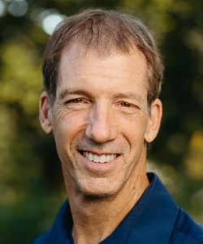
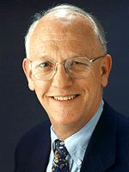
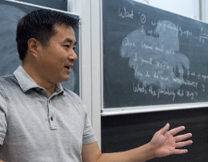
Lapse Prediction in Patients with Alcohol Use Disorder
151 patients with AUD
Early in recovery (1-8 weeks)
Committed to abstinence throughout study period
Followed for up to 3 months
Collected active and passive personal sensing data streams
GOAL: Develop a temporally precise lapse monitoring (prediction) system for patients with AUD
J. Curtin (PI)
D. Gustafson (Co-I)
X. Zhu (Co-I)
Notes:
So let me transition now to describing how we are taking the first baby steps toward developing smart digital therapeutics for SUD
We have recently completed a NIAAA funded project where we collected data from 151 participants who were in early recovery from a moderate to severe alcohol use disorder.
These participants were committed to abstinence at the start of the study and we followed them for up to 3 months, collecting a variety of active and passive personal sensing data streams.
Our first goal with this grant was to develop machine learning algorithms that can generate temporally precise predictions about when future lapses back to alcohol use will occur for patients with AUD.

Slide 10
Personal Sensing Data Streams
4X daily ecological momentary assessments (EMA)
Monthly self-report
Geolocation (GPS)
Cellular communications (voice and text messages)
Meta data
Text message content
Sleep sensor (Wake/sleep times; sleep efficiency; wakings; restlessness)
Notes:
As I mentioned, in this project, we collected a variety of active and passive personal sensing data streams.
Participants completed brief (7-10 item) ecological momentary assessments or EMAs, 4 times per day
We also have
- more temporally coarse, monthly self reports,
- Moment by moment geolocation,
- Meta data from their cellular communications and the actual content of their text messages,
- and we had sleep sensors in their beds.
We are in the early stages of model building at this point and I will focus today on results from models using only EMA. However, we are actively working with GPS and I’ll end with some brief discussion of those preliminary models as well

Slide 11
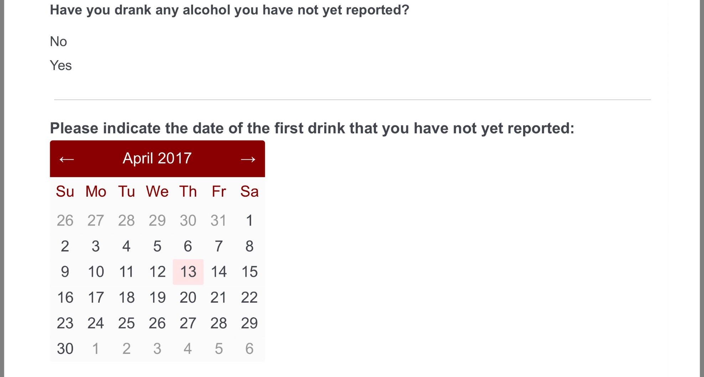
4x Daily Ecological Momentary Assessments
Current
Craving
Affect
Risky situations
Stressful events
Pleasant events
Future
Risky situations
Stressful events
Confidence
Notes:
So let me tell you a bit more about the 4x daily EMA we collected.
On each EMA, participants reported the date and time of any lapses back to alcohol use that they hadn’t previously reported.
All of the EMAs also asked them about their current craving, affective valence and arousal, recent risky situations, and recent stressful and pleasant events since their last EMA.
On the first EMA each day, they also reported any future risky situations and stressful events that they expected in the next week and their confidence that they would remain abstinent.

Slide 12
Feature Engineering
Features based on recent past experiences (12, 24, 48, 72, 168 hours)
Min, max, and median response (all items)
History (count) of past lapses (item 1) and completed EMAs (compliance)
Raw scores and change scores (from baseline/all past responses)
Notes:
We used these raw EMAs to engineer about 300 features to use in machine learning models to predict future lapses
We formed features by aggregating EMA items over various past time periods ranging from 12 -168 hours in the past
We calculated mins, maxes and medians for the EMA items in these time periods
We also calculated counts of past lapses and counts of past EMAs completed to index compliance
And we included these scores both in raw form and as change from baselines for the participant based on all their previous responses since the start of the study.

Slide 13
Machine Learning Methods
Predict hour-by-hour probability of future lapse
Lapse window widths
1 hour
1 day
1 week
Notes:
For our purposes today I wont dive deep into the machine learning methods but let me highlight a few high level details
We used these features I just described to make predictions about the hour-by-hour probability of a future lapse. We are developing separate models for three future lapse windows – lapses in the next hour, lapses in the next day, and lapses in the next week.
For example, if I was in recovery from an AUD, I could use these models to generate the probability that I would lapse after this symposium starting at 4pm. One model would generate the probability of a lapse between 4pm and 5 pm today, the second would predict the probability of a lapse between 4 pm today and 4pm tomorrow and the third would provide the probability of a lapse between 4 pm today and 4pm next Tuesday.
And of course, all of the models would only use data collected prior to 4 pm today so that they are “predicting”, in the full sense of the word, into the future and not just demonstrating an association.
[CAN ADD INFO TO THIRD PARAGRAPH ABOUT FEATURES USED FROM MOST RECENT TO 168. CONSIDER INCLUDING INFO ABOUT ~ NUMBER OF HOUR OBSERVATIONS TOO.

Slide 14
Machine Learning Methods
Statistical Algorithms
ElasticNet GLM (e.g., LASSO, ridge regression)
Random Forest
XGBoost
KNN
Model Tuning and Performance Evaluation
Area under ROC curve (AUC) as primary performance metric
Sensitivity, Specificity, Balanced accuracy, Positive predictive value
Using grouped (by participant) 10-fold CV
Notes:
We are evaluating machine learning model configurations that differ by common statistical algorithms.
We are evaluating these models primarily using the area under the ROC curve but we also consider and report a variety of other common metrics.
And, of course, these performance metrics are calculated for new observations and new participants that the models have never seen and were not trained on by using grouped 10-fold cross-validation.

Slide 15
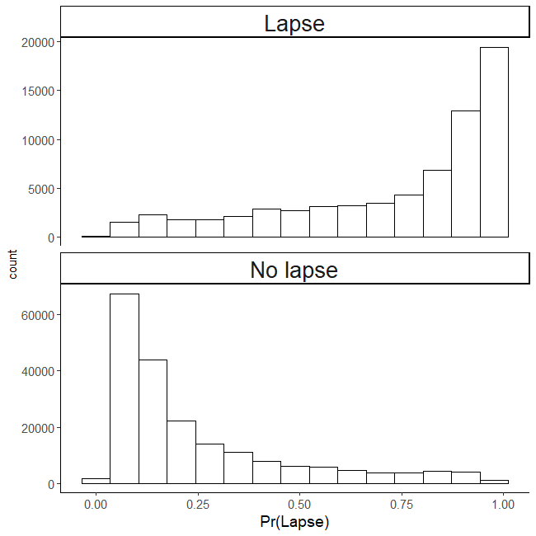
1 Week: Probabilities for No Lapse and Lapse
Model predicts probability of lapse in next week for “new” observations in test set
Can panel predictions for GROUND TRUTH lapse and no lapse observations
Want high probabilities to be high for true lapses and low for true no lapses
Notes:
Ok, lets start with the model that provides the coarsest level of temporal specificity – 1 week, and let me take a moment to make the predictions that this machine learning model provides more concrete for you
On the right, you are looking at histograms of the lapse probability predictions that the model makes for all the weeks for all the patients in the test set.
I’ve paneled these histograms by whether a lapse did or did not happen in reality for each predicted week. The top panel is for weeks with lapses and the bottom panel is for weeks with no lapses.
Ideally, you want the predicted probabilities to be very high for weeks where there was a lapse and very low for weeks where there was no lapse.
And this is exactly what we see for the one week lapse window model

Slide 16
1 Week: Probabilities for No Lapse and Lapse
Model predicts probability of lapse in next week for “new” observations
Can panel predictions for GROUND TRUTH lapse and no lapse observations
Want high probabilities to be high for true lapses and low for true no lapses
Need decision threshold for classification (.50 default)
Notes:
Now to move from probabilities to actual categorical decisions – in other words, predicting a lapse or no lapse in some specific week, we need a decision threshold. A probability of .50 is often used for this threshold, but as we will discuss later, there are times when we might want to choose other thresholds.
But for now, I will use .5 such that the model will predict “lapse” for all weeks with probabilities > .5 and it will predict “no-lapse” for all weeks with probabilities < .5

Slide 17
Performance Metrics by Lapse Window Width
 | 1 week | 1 day | 1 hour
AUC
Sensitivity | 0.79
Specificity | 0.86
Balanced accuracy | 0.82
Notes:
Using this decision threshold, we can now calculate the model’s sensitivity, specificity and balanced accuracy which is just the average of these two.
This one week lapse prediction model correctly predicts “lapse” for 79 percent of the weeks that contain a lapse and it correctly predicts “no-lapse” for 86 percent of the weeks that do not include a lapse.

Slide 18
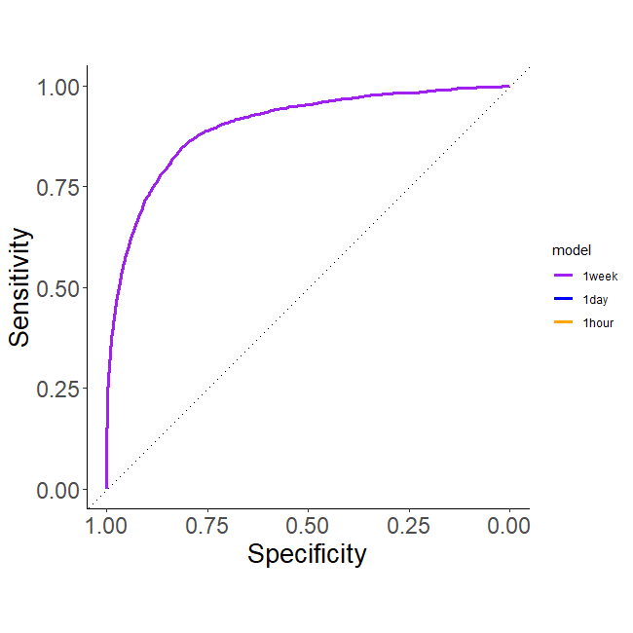
1 Week: ROC Curve
Area under the ROC curve (AUC)
Across all decision thresholds
~.5 (random) – 1.0 (perfect)
AUC = .90
Coarse rules of thumb for AUC
.70 - .80 are considered fair
.80 - .90 are considered good
> .90 are considered excellent
Notes:
But as I said, depending on the application, we may not want to always use a .5 decision threshold. And this is where the ROC curve and the area under this curve come into play as a performance metric. The ROC curve is a plot of the model’s sensitivity by its specificity across all possible decision thresholds.
The area under this curve can range from approximately .5 for a random classifier to 1.0 for a classifier that performs perfectly.
And the AUC for our 1 week model is .90, which is generally considered excellent performance.

Slide 19
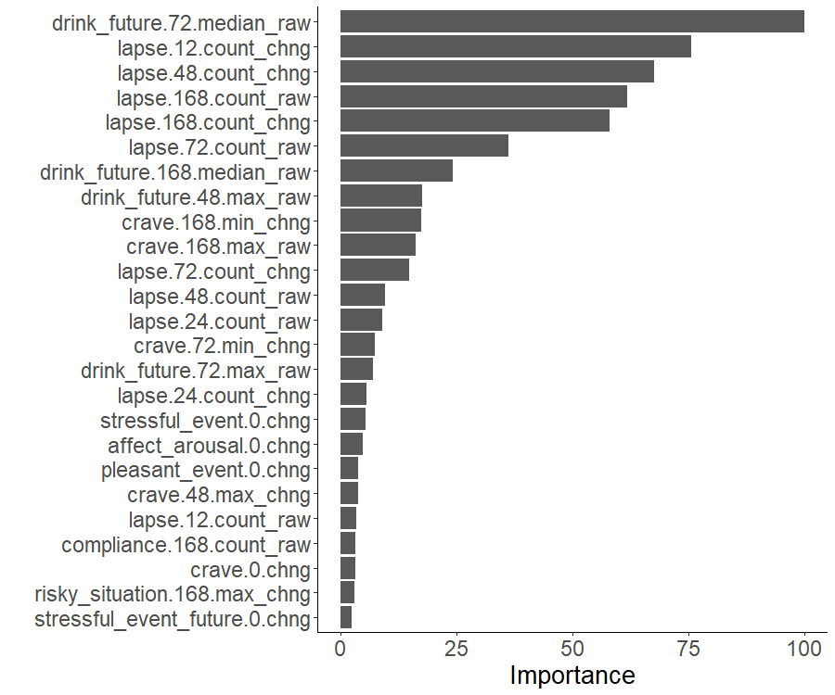
1 Week: Features
Small number of features are important
8 EMA items
Past lapses (item 1)
Craving (item 2)
Risky situation (item 3)
Stressful events (item 4)
Pleasant events (item 5)
Affective arousal (item 7)
Expected future risky situation (item 8)
expected future drinking (item 10)
EMA compliance
Counts, median, mins and maxes are useful
Both raw score (_raw) and change from baseline (_chng) are useful
Notes:
In the spirit of making this model more transparent and interpretable, lets briefly look under the hood at the feature importance for the top 25 features
The plot on the right shows feature names and their associated importance. From this we see a few important characteristics of the model.
First, only a small number of the approximately 300 features contribute meaningfully to predictions. You can see that the importance is already skewing toward 0 even among the first 25 important features
Second, 8 of the 10 EMA items are represented among these features.
And counts, mins, maxes, and medians, as well as raw and chng scores across all time periods all make contributions.

Slide 20
1 Day: ROC Curve
Coarse rules of thumb
.70 - .80 are considered fair
.80 - .90 are considered good
> .90 are considered excellent
Notes:
So we were very encouraged by the performance of this model because it exceeded the performance of the only other published week level lapse prediction model that we were aware of.
But we were also eager to see how well we could do if we required a higher level of temporal precision by developing a day level model.

Slide 21
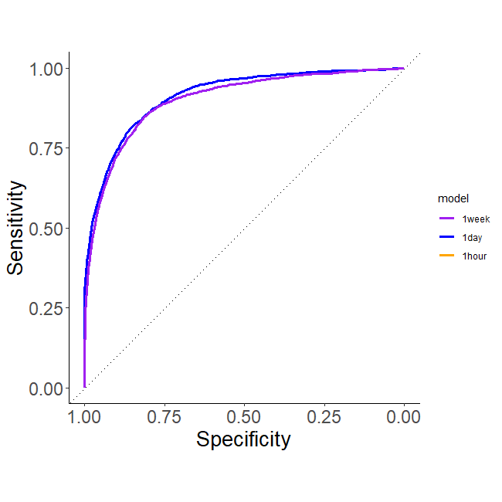
1 Day: ROC Curve
AUC = .90
AUC = .91
Coarse rules of thumb
.70 - .80 are considered fair
.80 - .90 are considered good
> .90 are considered excellent
Notes:
And here is the ROC curve and the AUC for the day level model in blue, superimposed on the week level model in purple.
The day level model performed as well as, if not better, than the week level model with an AUC of .91
[PAUSE]

Slide 22
Performance Metrics by Lapse Window Width
 | 1 week | 1 day | 1 hour
AUC | 0.90 | 0.91
Sensitivity | 0.79 | 0.81
Specificity | 0.86 | 0.86
Balanced accuracy | 0.82 | 0.83
Notes:
And consistent with this higher AUC, the day level model also had slightly better sensitivity and balanced accuracy, along with comparable specificity to the week level model
[PAUSE]

Slide 23
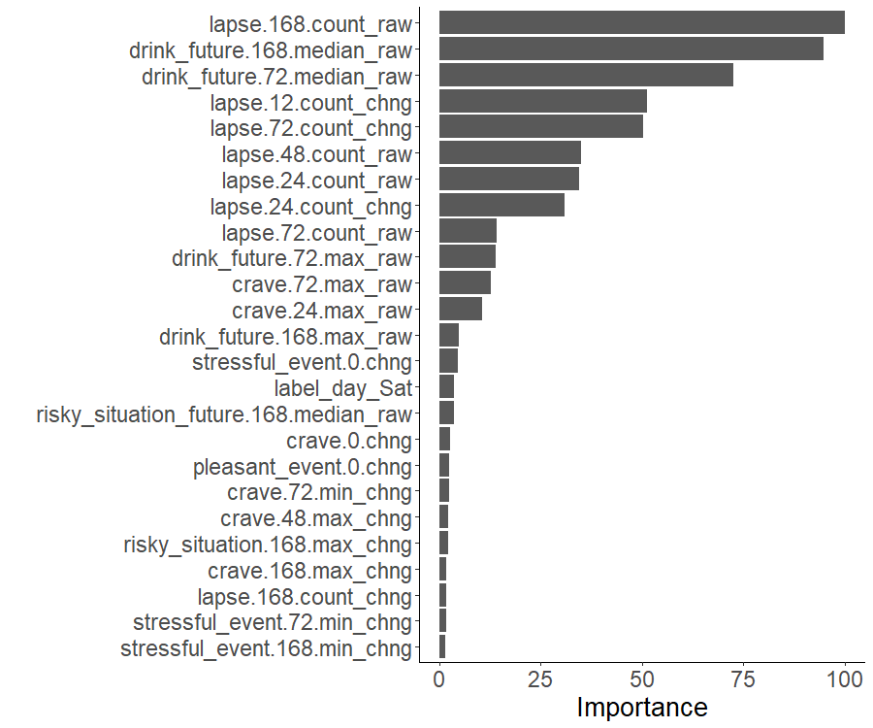
1 Day: Features
Similar (fewer unique?) EMA items
Day emerges as new feature (Saturday)
Notes:
We can look at the important features for this model too to get a sense of how it works.
The important EMA items are similar to the week model although this day level model seems to depend more on fewer unique EMA items.
And the day of the week for the lapse window emerges as a useful predictor. Not surprisingly, Saturdays have higher probability of lapse than other days of the week and the model can take advantage of this.

Slide 24
1 Hour: ROC Curve
Coarse rules of thumb
.70 - .80 are considered fair
.80 - .90 are considered good
> .90 are considered excellent
Notes:
Given our success with this day level model, we next developed a model with the highest level of temporal precision we could build given how we measured lapses, which was the hour level model.

Slide 25
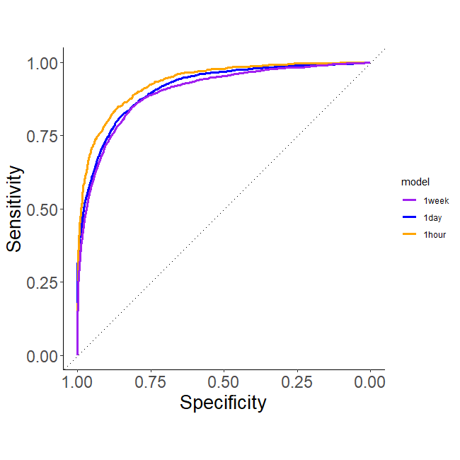
1 Hour: ROC Curve
AUC = .90
AUC = .91
AUC = .93
Coarse rules of thumb
.70 - .80 are considered fair
.80 - .90 are considered good
> .90 are considered excellent
Notes:
And it turns out that we can do somewhat better still with hour level predictions. Here the orange curve represents the ROC curve for the hour level model, which had the best AUC yet, .93
[PAUSE]

Slide 26
Performance Metrics by Lapse Window Width
 | 1 week | 1 day | 1 hour
AUC | 0.90 | 0.91 | 0.93
Sensitivity | 0.79 | 0.81 | 0.84
Specificity | 0.86 | 0.86 | 0.87
Balanced accuracy | 0.82 | 0.83 | 0.86
Notes:
And again, consistent with that AUC, the sensitivity, specificity, and balanced accuracy were higher still for this model.
[PAUSE]

Slide 27
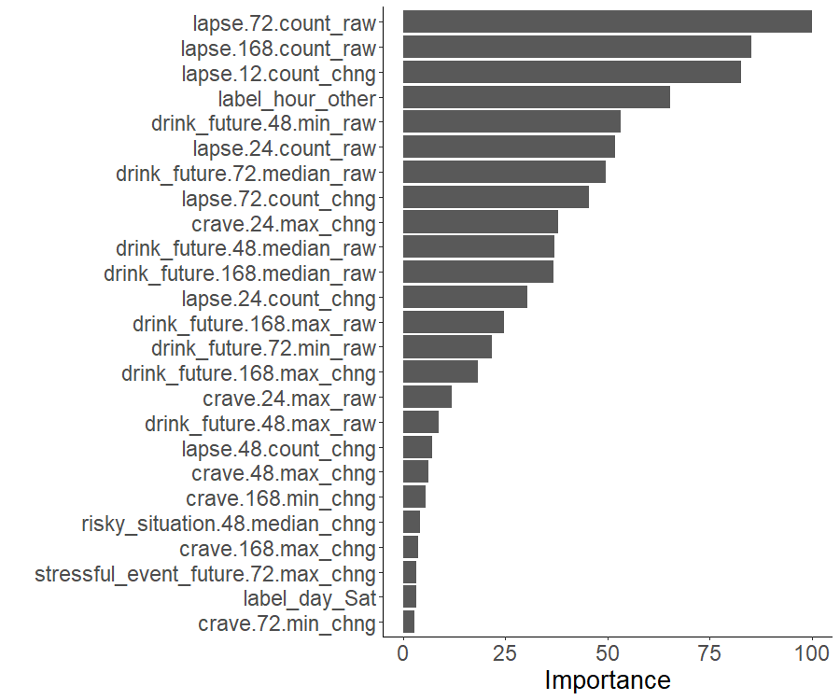
1 Hour: Features
Past reports from previous 0 – 168 hours are still useful
Still fewer unique EMA items
Day still matters
Hour matters (evening/5pm – midnight vs. other)
Notes:
Looking at the important features, we see this model uses fewer still unique EMA items (only 5 of the 10 items)
The day associated with the lapse window still matters - hours on Saturday are still higher risk
But now we can also use the hour of the lapse window as a feature too. And again not surprisingly, lapses are higher probability between 5 pm and midnight than at other times of the day across all days

Slide 28
Positive Predictive Value (PPV)
 | 1 week | 1 day | 1 hour
AUC | 0.90 | 0.91 | 0.93
Sensitivity | 0.79 | 0.81 | 0.84
Specificity | 0.86 | 0.86 | 0.87
Balanced accuracy | 0.82 | 0.83 | 0.86
PPV
Notes:
Lets return one more time to the performance of these models because I would be remiss if I didn’t complicate the story a bit before we close.
Clearly, the sensitivity, specificity, and balanced accuracy of all three of these models is encouragingly high
But what is often missed when we evaluate the performance of machine learning models is their positive predictive value or PPV.
PPV looks at the percentage of positive predictions from the model that are actually true lapses. And PPV is often lower when the positive event, in our case, lapses, is infrequent.

Slide 29
Positive Predictive Value (PPV)
 | 1 week | 1 day | 1 hour
AUC | 0.90 | 0.91 | 0.93
Sensitivity | 0.79 | 0.81 | 0.84
Specificity | 0.86 | 0.86 | 0.87
Balanced accuracy | 0.82 | 0.83 | 0.86
PPV
% Lapse: 25.4%
% Lapse: 7.7%
% Lapse: 0.4%
Notes:
Now we haven’t talked about the frequency of lapses across the three lapse windows, but it should be intuitively clear that the percent of weeks that contain a lapse will be higher than the percent of days that contain a lapse, and that the percent of hours that contain a lapse will be lower still.
And this is what we see in our data.

Slide 30
Positive Predictive Value (PPV)
 | 1 week | 1 day | 1 hour
AUC | 0.90 | 0.91 | 0.93
Sensitivity | 0.79 | 0.81 | 0.84
Specificity | 0.86 | 0.86 | 0.87
Balanced accuracy | 0.82 | 0.83 | 0.86
PPV | 0.65 | 0.32 | 0.02
% Lapse: 25.4%
% Lapse: 7.7%
% Lapse: 0.4%
Notes:
Because of this, we see relatively low PPV for our models – and particularly the day and the hour level models.
These models catch most lapses (they have hi sensitivity), and they correctly label most no-lapse observations as well (hi specificity). But when you consider their positive predictions, a high percentage of these lapse predictions are false alarms.
This has two big implications.
First, we need to consider the impact of false alarms when using these predictions. It may not be problematic to encourage the patient to use their digital therapeutic in cases where the model makes a positive lapse prediction because the cost of a false alarm in that instance is low. More DTx use is likely always good.
But we may not want to encourage the use of more costly treatments if PPV is low.

Slide 31
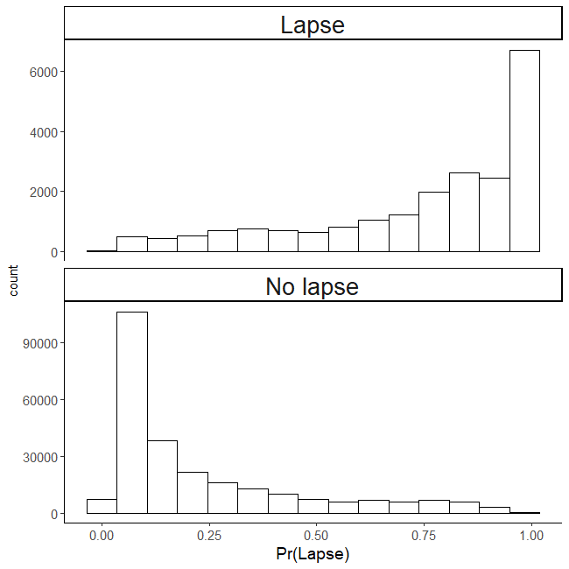
Impact of Decision Thresholds on Performance: 1 day
 | Threshold = .50
Sensitivity | 0.81
Specificity | 0.86
PPV | 0.32
Notes:
Second, if we need higher PPV, we may be able to get it by using a decision threshold that is higher than .5
Here I am showing you the performance of the day level model when we use the default .5 threshold that you saw previously

Slide 32
Impact of Thresholds on Performance: 1 day
 | Threshold = .50 | Threshold = .90
Sensitivity | 0.81 | 0.40
Specificity | 0.86 | 0.99
PPV | 0.32 | 0.83
Notes:
But if we move the threshold up to .9 before we call an observation a lapse, we can increase the PPV from .32 to .83.
And this is what we will need to do if we want to recommend more costly treatments or other actions where false alarms may be problematic.

Slide 33
Key Take Home Messages
Relatively high combined sensitivity and specificity
Comparable performance (AUC) from 1 week down to 1 hour windows
Will need to adjust decision thresholds to fit how we use the algorithm.
Lower PPV OK for low burden or low cost recommendations
Higher PPV needed to recommend “costly” interventions or actions
Notes:
So to recap our main take-aways
- We were generally encouraged by these preliminary models.
- We’ve demonstrated that we can get relatively high combined sensitivity and specificity
- We can do this for not only coarse one week windows but also temporally precise windows down to one hour
- But we also recognize that depending on what we will use the predictions for, we may need to adjust decision thresholds to trade off sensitivity for greater positive predictive value.

Slide 34
(Selective) Next Steps
GPS and other passively sensed signals
Notes:
One of the key next steps is to develop models that rely more on passive sensing rather than EMA to lower the patient burden of using these systems long term. To this end, we have started to build preliminary models using GPS.
There is clearly predictive signal in the GPS but likely not enough to stand alone as the only features. We are seeing AUCs in the low .7s when we use only GPS to predict future lapses.
However, when we add GPS to the EMA models that I described today, we appear to need fewer unique EMA items to get the same level of model performance. So the addition of GPS may serve to lower patient burden while maintaining model performance.

Slide 35
(Selective) Next Steps
GPS and other passively sensed signals
Build models with lead times > 0 hours
Notes:
NEED TEXT FOR THIS BUT ITS IMPORTANT. FOCUS ON lead = 0 for 1 hour and JIT – distraction, urge surfing but lead = 1 week for contact with therapist, sponsor, supportive friends and family, etc.

Slide 36
(Selective) Next Steps
GPS and other passively sensed signals
Build models with lead times > 0 hours
More diversity in training data
Notes:
We are excited by the early performance of these machine learning models BUT I want to be clear that these are preliminary research studies. And they included mostly white participants from our local community in Madison, WI.
Models trained on these participants would be unlikely to work well with black and brown patients or patients from rural communities.
Machine learning models must be trained on diverse samples of patients or their use may exacerbate rather than reduce existing mental healthcare disparities.
We are now collecting data for a NIDA funded project where we are specifically recruiting for racial, ethnic, and geographic diversity across the entire United States.

Slide 37
(Selective) Next Steps
GPS and other passively sensed signals
Build models with lead times > 0 hours
More diversity in training data
Use models to improve DTx engagement and clinical outcomes
“Clinician-guided” real-time use of DTx based on lapse probability and features
How to craft patient feedback to encourage trust in the algorithm
Notes:
Of course, accurately predicting future lapses is only useful if these predictions can be used to sustain engagement with treatments and improve clinical outcomes.
We have now started to consider how we can use these predictions to help patients optimize their use of a digital therapeutic.
These models may be able to suggest when more use of the DTx is needed because lapse risk is increasing or high but we are also hoping that we can use the models to recommend which tools and supports in the DTx are best for that patient at that moment in time given their lapse risk probability and dominant features contributing to the lapse prediction.
We are also sensitive to the fact that these recommendations from the machine learning models will need to be provided to patients in a transparent manner that also encourages them to trust the algorithm and follow its recommendations.
These are big challenges but we if meet these challenges, we can begin to move from the current beta versions of digital therapeutics to smarter, personalized treatments powered by sensing and AI.
Thank you.

Slide 38
CRediTs
This research is highly collaborative and requires many hands.
Kendra Wyant (doctoral student): data curation, conceptualization, formal analysis, software
Sarah Sant’ana (doctoral student): data curation, conceptualization
Gaylen Fronk (doctoral student): conceptualization
John Curtin (faculty): conceptualization, formal analysis, funding acquisition, methodology, software, supervision
David Gustafson (faculty): conceptualization
X. Zhu (faculty): conceptualization, methodology
Candace Lightheart (staff) data curation, investigation, supervision
Susan Wanta (staff) project administration, software
Megan Schultz (staff) investigation, data curation
Jill Nagler (staff) investigation
Kerry Keiser (staff) investigation
Chris Gioia (staff) clinical supervision
http://go.wisc.edu/arc
jjcurtin@wisc.edu

Slide 39
Supplemental Slides

Slide 40
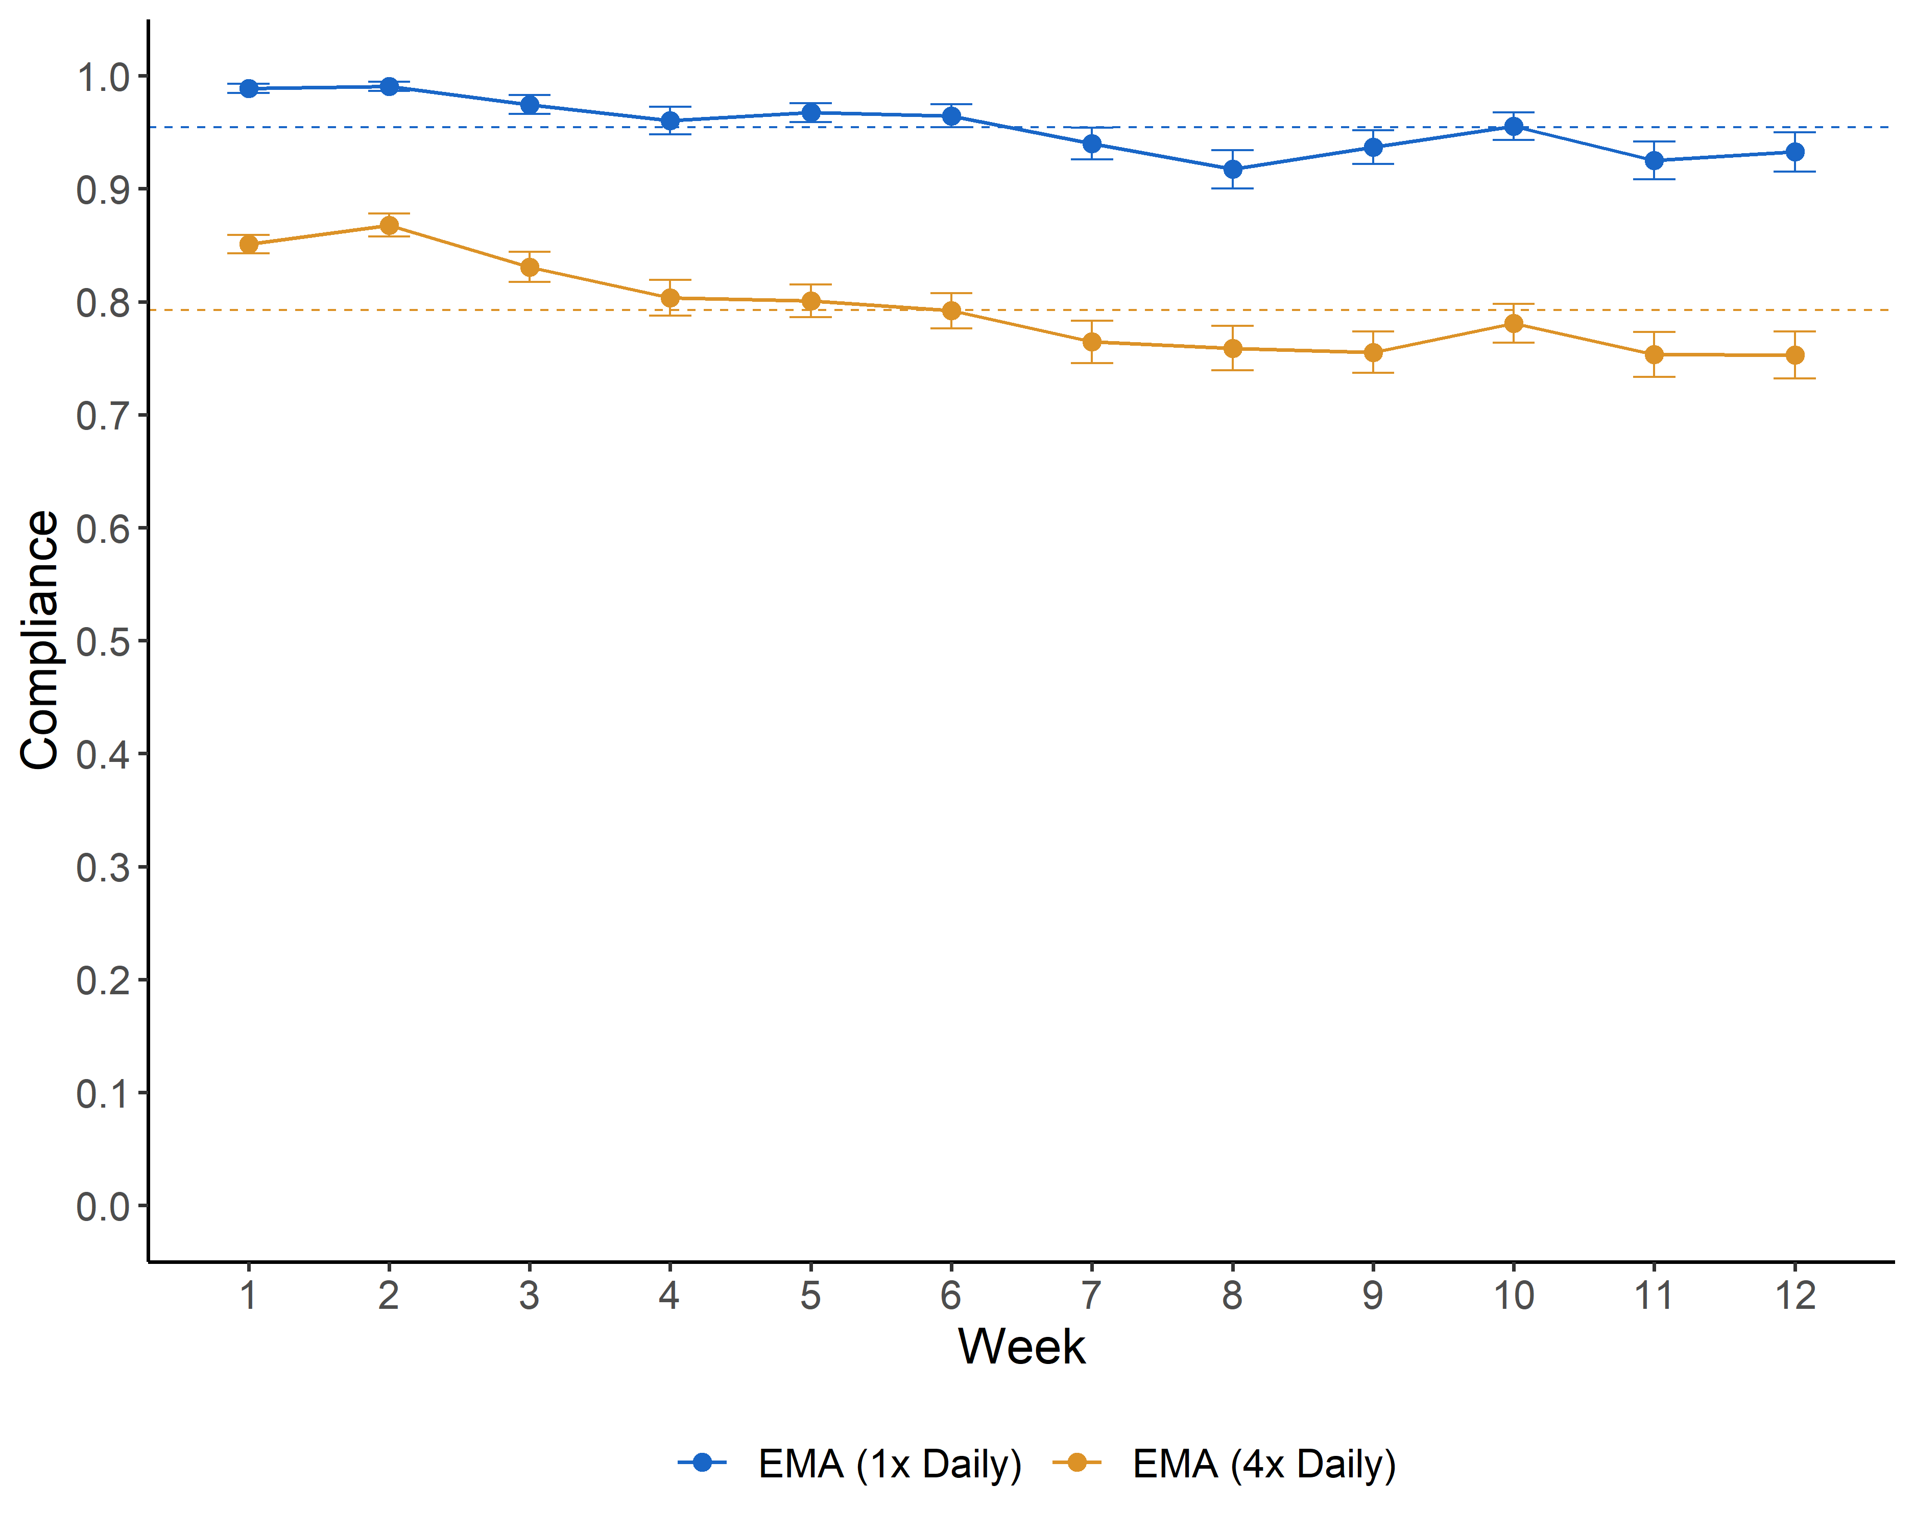
Feasibility and Acceptability of EMA

Slide 41
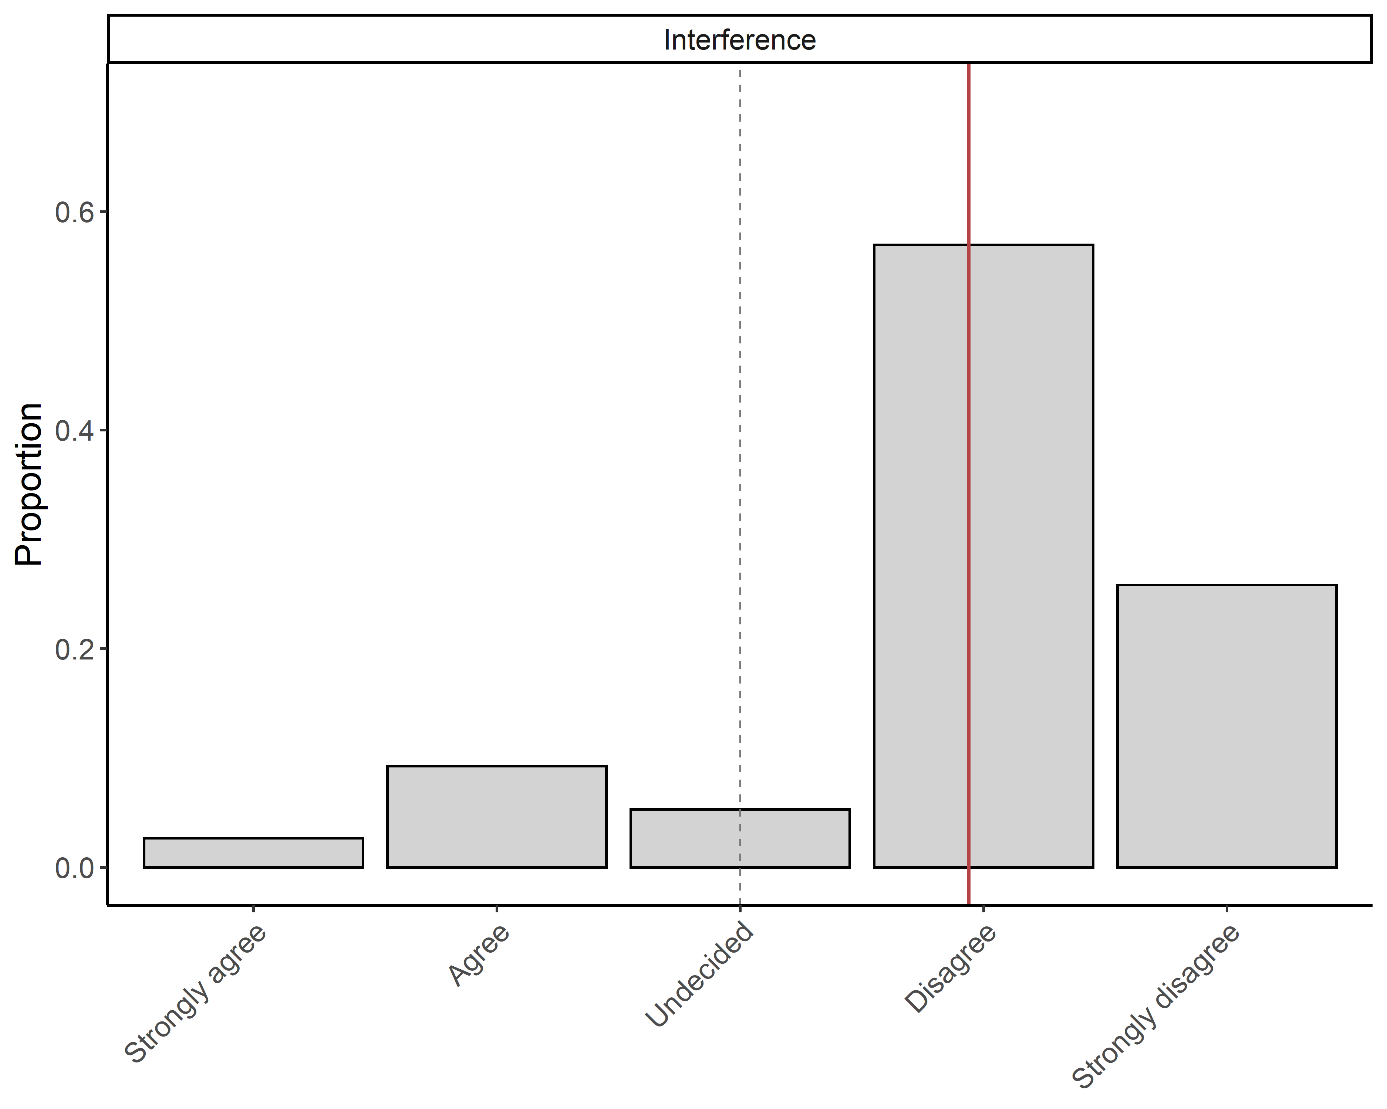
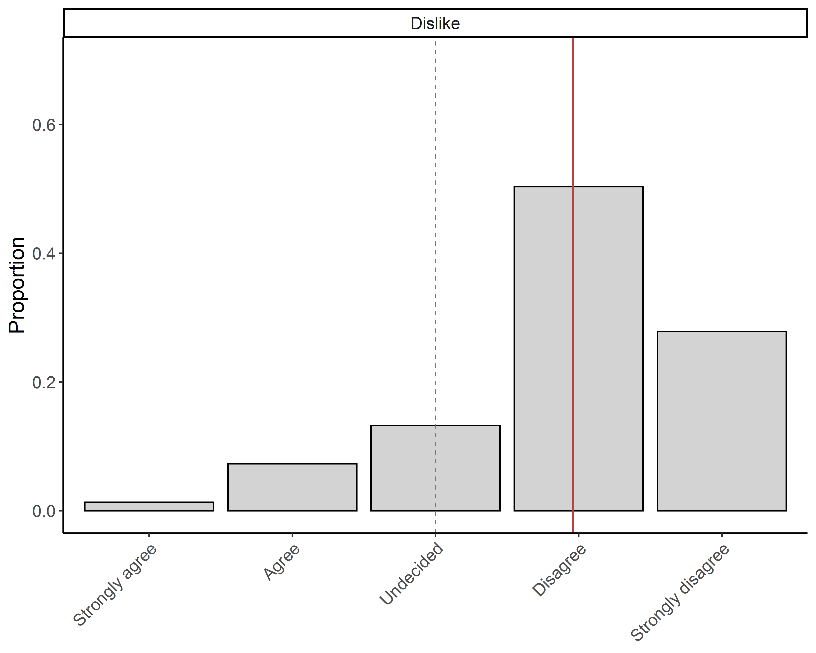
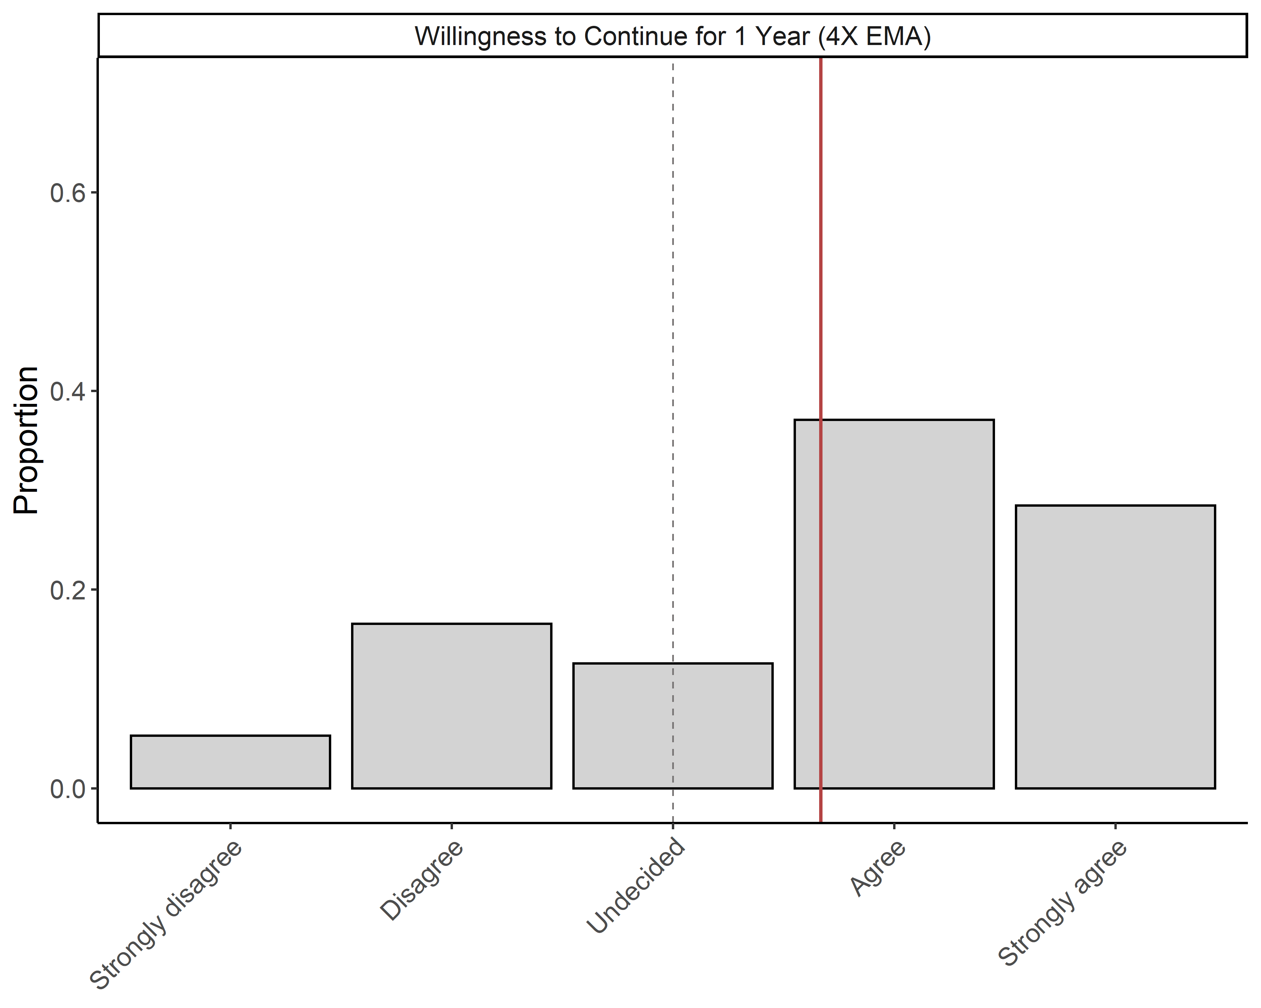
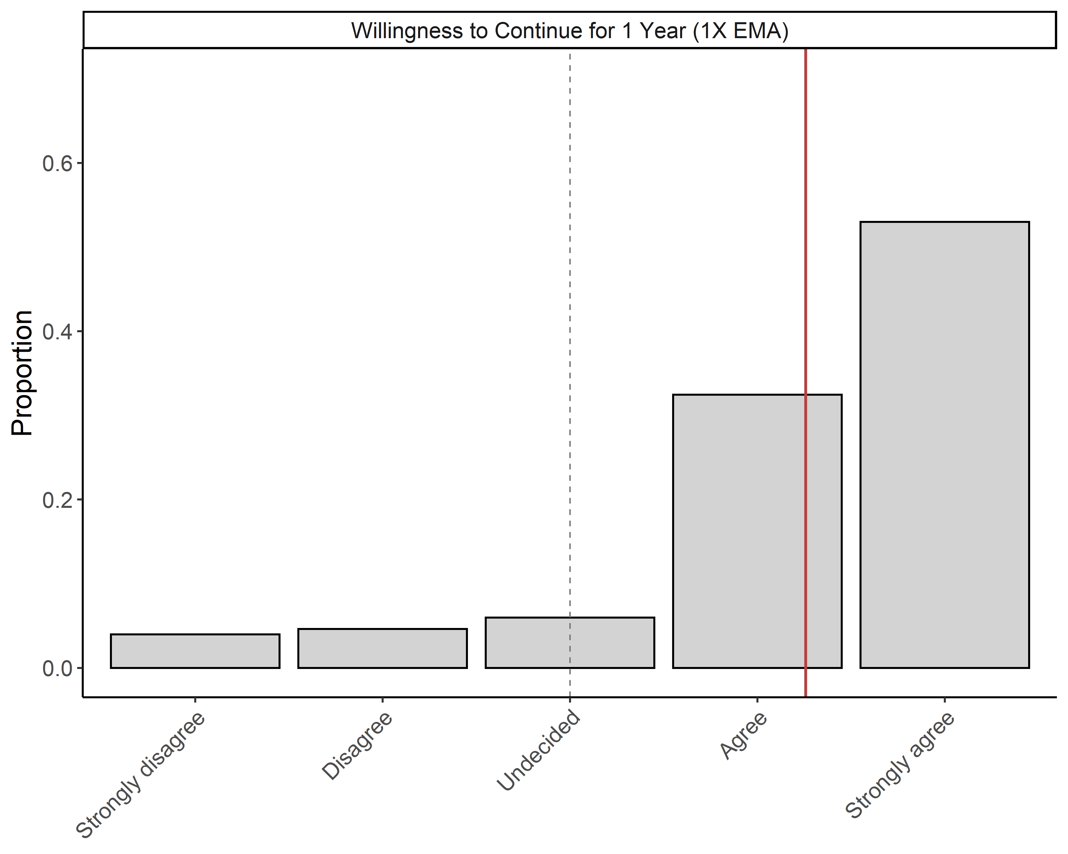
Feasibility and Acceptability of EMA

Slide 42
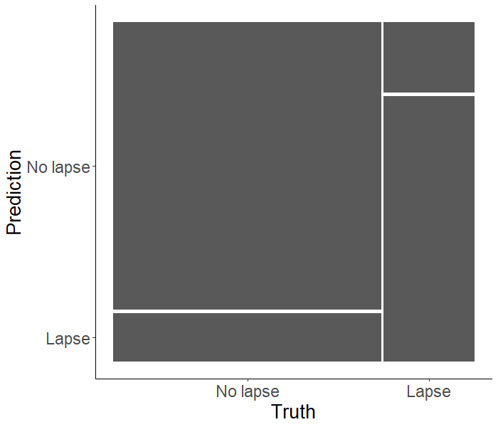
1 Week: Confusion Matrix and Performance Metrics
Sensitivity = 0.79
Specificity = 0.86
Balanced accuracy = .82
TN
FN
FP
TP
Decision threshold = .50

Slide 43
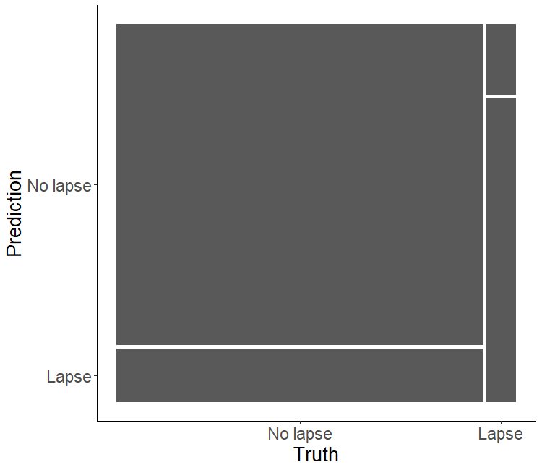
1 Day: Confusion Matrix and Performance Metrics
Sensitivity = 0.81
Specificity = 0.86
Balanced accuracy = .83
TN
FN
FP
TP
Decision threshold = .50

Slide 44
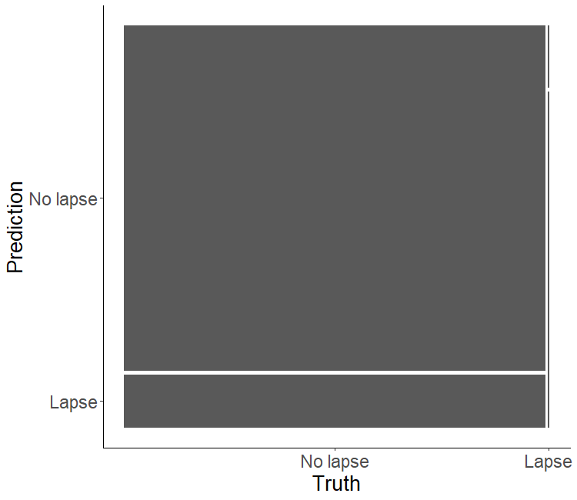
1 Hour: Confusion Matrix and Performance Metrics
Sensitivity = 0.84
Specificity = 0.87
Balanced accuracy = .86
TN
FN
FP
TP
Decision threshold = .50

