Slide 1
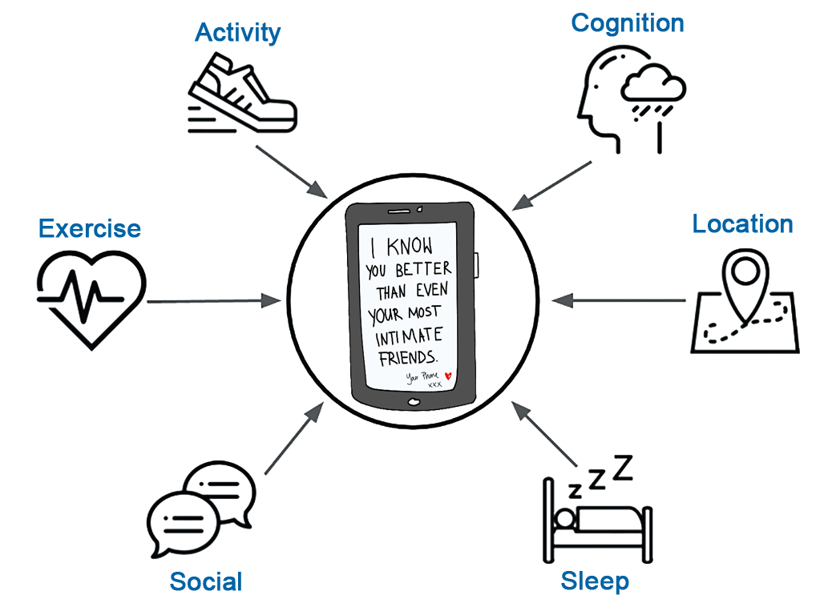
Developing Smart Digital Therapeutics
for Substance Use Disorders
John J. Curtin, PhD
jjcurtin@wisc.edu
http://go.wisc.edu/arc

Slide 2
Outline for Today
(Very brief) rationale for digital therapeutics
Focus on two NIH funded projects
Coarse review of methods
Deeper discussion personal sensing methods, modeling goals, and statistical methods
Review performance of “baseline” models (progress report)
Discuss key issues for progress toward development of “smart digital therapeutics”
Very interested in critique, discussion, debate, suggestions
Joined by Kendra Wyant – key doctoral student/data scientist for projects

Slide 3
Mental Health Needs are High and Unmet
In 2019, approximately 52 million adults in the US experienced some form of active mental illness
More than half did not receive any treatment
20 million adults had an active substance use disorder
9 out of 10 did not receive any treatment
Many barriers to traditional SUD treatments
Access
Availability
Affordability
Acceptability
Notes:
The need for mental health services is very high and the practical capacity of our current system to meet this need is woefully inadequate
STATS

Slide 4
Digital Therapeutics (DTx)
Digital therapeutics are software programs or "apps" that are designed to prevent, manage, or treat disease, including mental illness.
Can augment mental health services to address barriers
Accessible anywhere
Available 24/7
Highly scalable (affordable?)
Acceptable?
Effective!

Slide 5
Digital Therapeutics for SUD are here today
A-CHESS (research tool)
Connections (CHESS Health)
RESET, RESET-O (Pear Therapeutics)
Substantial research and use of DTx in VA system
Notes:
Connections
A-CHESS
Kathleen Carrolls CBT4CBT
RESET
Lisa Marsch’s Therapeutic Education System (TES)

Slide 6
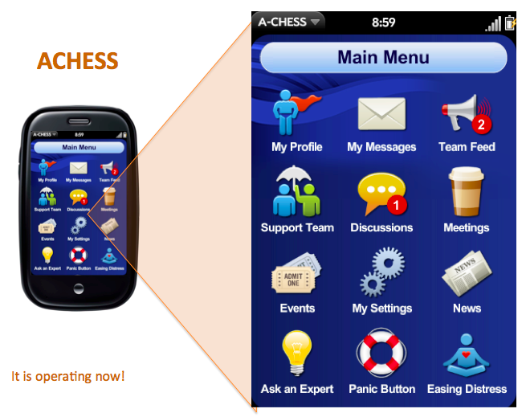
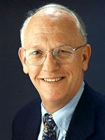
Addiction-Comprehensive Health Assessment Support System
Social Support
Discussion groups
Peer-to-peer
Panic button
Education and training
Distracting games
Guided relaxation & mindfulness
Tailored information and stories
Healthy event newsletter
Alerts
Appointment reminders
Medication reminders
Risk alerts
Clinician alerts
Assessments
EMA
Scheduled assessments
A-CHESS use
Virtual Counseling
Assertive outreach
Counselor contact
Video conferencing
A-CHESS
D. Gustafson

Slide 7
RCT Evidence of A-CHESS Efficacy
N=349; recruited from residential care for AUD
Randomly assigned to A-CHESS vs. TAU for 8 months
Follow-ups at 4, 8, and 12 months
Effective across the entire study period
Benefits were meaningful and enduring
Reduced risky drinking days > 50% at 12 months
Doubled the odds of abstinence at 12 months

Slide 8
Patients don‘t self monitor well
SUD is a chronic relapsing disorder
Life-long risk monitoring is difficult
Use of A-CHESS is sustained only “moderately well”
Patients often didn’t use A-CHESS prior to lapse/relapse
Patients may not have used the optimal interventions and supports for them
"Could you predict not only who might be at greatest risk for relapse but precisely when that relapse might occur and how best to intervene to prevent it?"
Notes:
My research team became interested in DTx when Dave approached us with a simple question. He asked... "Could you predict not only who might be at greatest risk for relapse but **precisely when** that relapse might occur and **how best to intervene** to prevent it"
he also noticed many of the people who relapsed hadn't used the app in the days leading up to that relapse. And others who had relapsed hadn't used the specific supports in the app that he would have thought would be most effective for them. He believed that the benefits of his app could be increased if the app knew the person well enough to recognize when they were at greatest risk for relapse and if it was smart enough to recommend the specific supports that would be most effective for them at that moment in time to prevent that relapse.

Slide 9
Smart DTx
Power of DTx comes from easy, 24/7 access to their many supports - their treatments, tools, and services.
But
When should I use them
For how long
Which of their many supports are best for me?
And which are best for me right now, at this moment in time?
Smart DTx can address these questions by adding personal sensing capabilities and machine learning prediction/recommendation systems

Slide 10
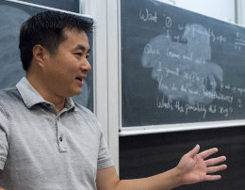
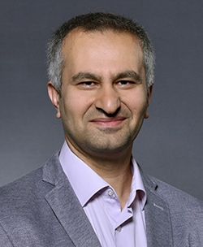
Lapse Prediction in Patients with Alcohol Use Disorder
151 patients with AUD
Early in recovery (1-8 weeks)
Committed to abstinence throughout study period
Followed for up to 3 months
Collected active and passive personal sensing data streams
GOAL: Develop a lapse monitoring (prediction) system for patients with AUD
D. Gustafson (Co-I)
X. Zhu (Co-I)
O. Alagoz (Co-I)

Slide 11
(Brief) Personal Sensing Primer
In situ measurement
Moment-by-moment quantification
Uses personal digital devices & wearable sensors
Smartphones is key
Can be collected actively or passively
Can provide rich and temporally precise measurement of thoughts, feelings, symptoms, and behaviors.

Slide 12
Personal Sensing Data Streams
Active signals
Trait self-report measures (1X at study start)
Temporally coarse self-report state measures (3X - monthly)
Temporally precise self-report
4X daily ecological momentary assessments
1X daily audio check-ins (text and audio signal)
Passive signals
GPS location
Places (location and time)
Tracks (location and movement type)
Voice and SMS (text messages) logs
Meta data
Message content
Sleep sensor (Wake/sleep times; sleep efficiency; wakings; restlessness)

Slide 13
Focus on Lapses and Lapse Prediction
Predict probability of lapse vs. relapse?
Lapse window width
1 week
1 day
1 hour
Lead time for prediction
Different combos of window width and lead time useful
JIT: lead = 0; width = 1 hour (1 day?)
Traditional Tx and supports: longer lead, window width can be wider
Frequency of predictions = 1 hour (~ 275,000 observations and predictions over subjects and days

Slide 14
Machine Learning Methods
Statistical Algorithms
ElasticNet GLM (e.g., LASSO, ridge regression)
Random Forest
XGBoost
KNN
Resampling for class imbalance (up, down, SMOTE)
Other techniques (e.g., modified cost functions) pending
Model Tuning and Performance Evaluation
AUC under ROC curve as primary performance metric
Sensitivity, Specificity, Balanced accuracy, positive predictive value
Using grouped 10-fold CV
Final Evaluation with grouped test set or nested CV
All models should be considered baseline models at this point

Slide 15
The Confusion Matrix and Performance Metrics
Ground Truth
 | No Lapse | Lapse
No Lapse | TN | FN
Lapse | FP | TP
Model
Prediction
Accuracy = (TN + TP) / TN + FP + FN + TP (coarse & misleading)
Sensitivity = TP / (TP + FN)
Specificity = TN / (TN + FP)
Balanced accuracy = (Sensitivity + Specificity) / 2
Positive predictive value = TP / (TP + FP)

Slide 16
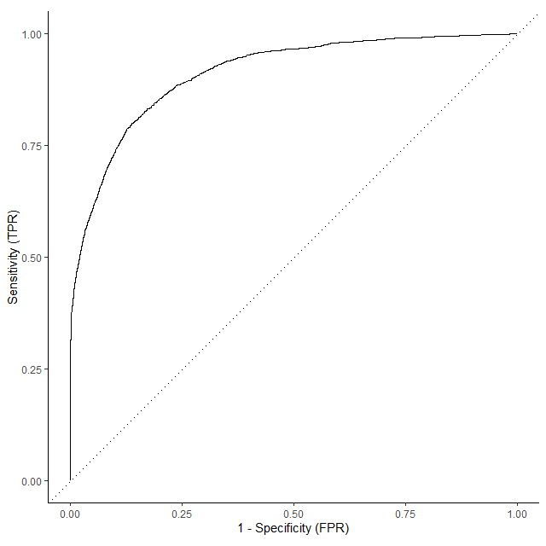
The Receiver Operating Characteristic (ROC) Curve
Most statistical algorithms yield probability predictions, P(Lapse)
We dichotomize these probabilities at some threshold to provide class predictions (lapse vs. no lapse)
ROC Curve plots sensitivity vs. specificity across all thresholds
Area under ROC Curve is useful performance metric
~ 0.5 – 1.0
Average across thresholds
Independent of outcome distribution
Notes:
So let me talk a moment to make the predictions that this machine learning model provides concrete
On the right, you are looking at predictions that the model makes for whether or not a specific patient will lapse on a specific day.
These are predictions for patients and days that the model hasn’t been trained on.
The model predicts the probability that a lapse will occur.
I’ve separated these predictions out by whether a lapse did or did not happen in reality for each predicted case.
Ideally, you want all the predicted probabilities to be very low (to the left) on days where there was not a lapse and very high (to the right) on days where there was a lapse.
You can see we are doing well on No Lapse days.
Also doing OK on lapse days but there are clearly some we are going to miss depending on what cut score we use to move from continuous probabilities to discrete dichotomous predictions of lapse or no lapse for each day within each patient.

Slide 17
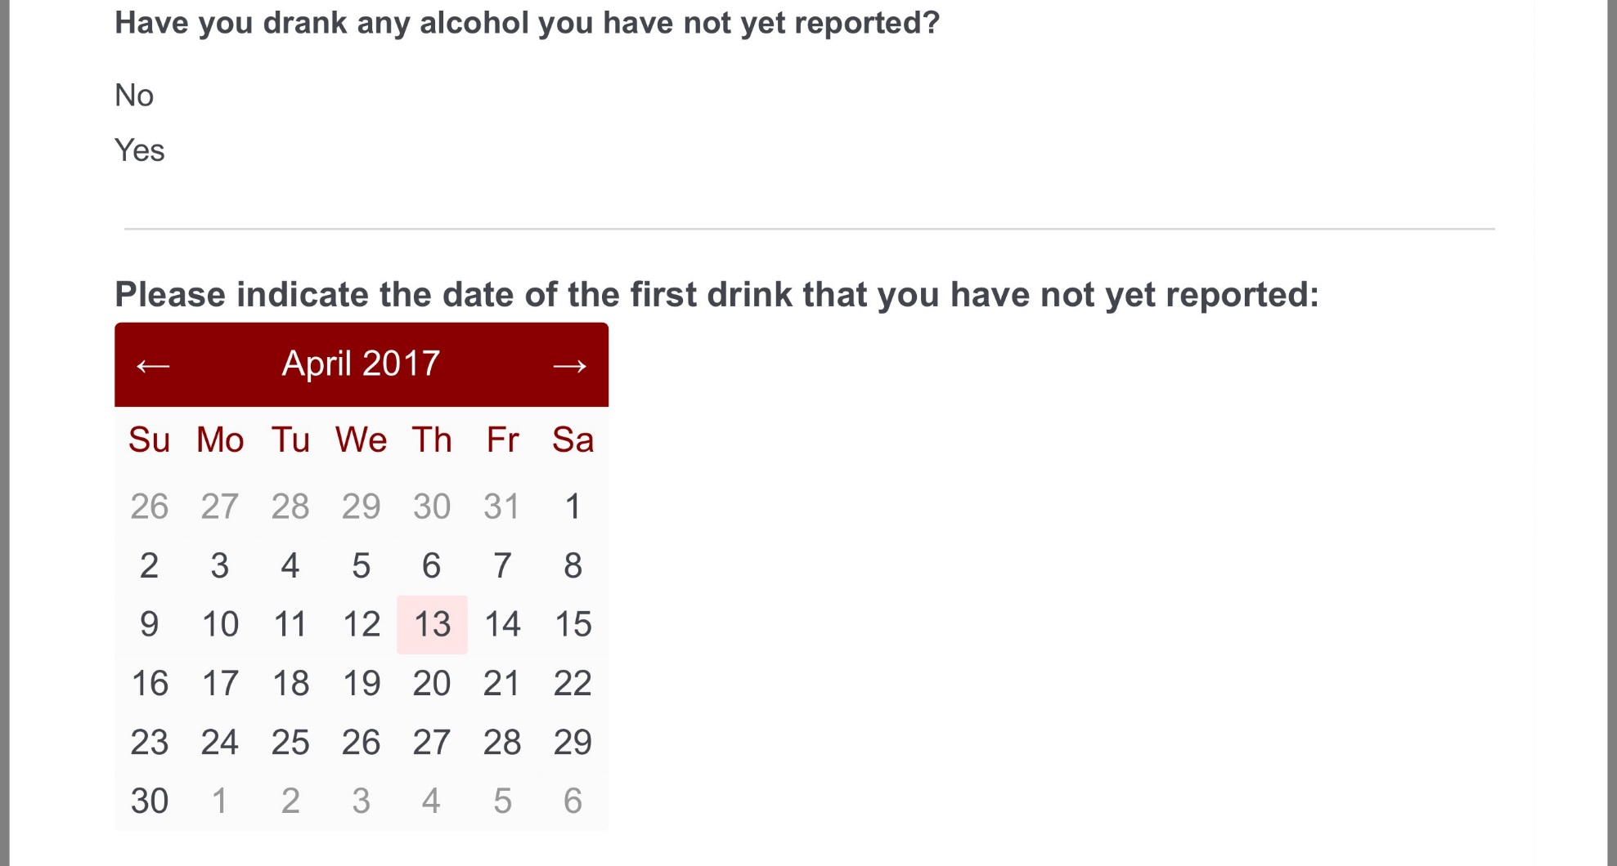
4x Daily Ecological Momentary Assessments
Current
Craving
Affect
Risky situations
Stressful events
Pleasant events
Future
Risky situations
Stressful events
Confidence
* Verified by monthly staff interview

Slide 18
Baseline Feature Engineering for EMA
Focus on recent past experiences (12, 24, 48, 72, 168 hours)
Raw scores and change scores (from baseline/all past responses)
Median response (all items)
History (count) of past lapses (item 1)

Slide 19
1 Week: Probabilities for No Lapse and Lapse
Model predicts probability of lapse in next week for “new” observations
Can separate predictions for GROUND TRUTH lapse and no lapse observations
Want low probabilities for true no lapse and high probabilities for true lapse
Need threshold for classification
Notes:
So let me talk a moment to make the predictions that this machine learning model provides concrete
On the right, you are looking at predictions that the model makes for whether or not a specific patient will lapse on a specific day.
These are predictions for patients and days that the model hasn’t been trained on.
The model predicts the probability that a lapse will occur.
I’ve separated these predictions out by whether a lapse did or did not happen in reality for each predicted case.
Ideally, you want all the predicted probabilities to be very low (to the left) on days where there was not a lapse and very high (to the right) on days where there was a lapse.
You can see we are doing well on No Lapse days.
Also doing OK on lapse days but there are clearly some we are going to miss depending on what cut score we use to move from continuous probabilities to discrete dichotomous predictions of lapse or no lapse for each day within each patient.

Slide 20
Optimal threshold = .42
1 Week: ROC Curve
AUC = 0.88
x
Coarse rules of thumb
.70 - .80 are considered fair
.80 - .90 are considered good
> .90 are considered excellent

Slide 21
1 Week: Confusion Matrix and Performance Metrics
Ground Truth
 | No Lapse | Lapse
No Lapse | 164,107 | 11,551
Lapse | 40,023 | 57,937
Model
Prediction
Sensitivity = 0.83
Specificity = 0.80
Balanced accuracy = .82
Optimal threshold = .42

Slide 22
1 Day: Probabilities and ROC Curve
AUC = .90

Slide 23
1 Day: Confusion Matrix and Performance Metrics
Ground Truth
 | No Lapse | Lapse
No Lapse | 221,030 | 4,310
Lapse | 35,133 | 17,091
Model
Prediction
Sensitivity = 0.80
Specificity = 0.86
Balanced accuracy = .83
Optimal threshold = .52

Slide 24
1 Hour: Probabilities and ROC Curve
AUC = .91

Slide 25
1 Hour: Confusion Matrix and Performance Metrics
Ground Truth
 | No Lapse | Lapse
No Lapse | 239,767 | 212
Lapse | 29,786 | 817
Model
Prediction
Sensitivity = 0.79
Specificity = 0.89
Balanced accuracy = .84
Optimal threshold = .57

Slide 26
Comparisons Across Window Width
 | 1 week | 1 day | 1 hour
AUC | 0.88 | 0.90 | 0.91
Sensitivity | 0.83 | 0.80 | 0.79
Specificity | 0.80 | 0.86 | 0.89
Balanced accuracy | 0.82 | 0.83 | 0.84

Slide 27
Comparisons Across Window Width
 | 1 week | 1 day | 1 hour
AUC | 0.88 | 0.90 | 0.91
Sensitivity | 0.83 | 0.80 | 0.79
Specificity | 0.80 | 0.86 | 0.89
Balanced accuracy | 0.82 | 0.83 | 0.84
PPV | 0.59 | 0.33 | 0.03

Slide 28
1 Week: Confusion Matrix and Performance Metrics
1 Week:
PPV = .59
% Lapse: 25.4%
1 Day:
PPV = .33
% Lapse: 7.7%
1 Hour:
PPV = .03
% Lapse: 0.4%

Slide 29
Impact of Thresholds on Performance: 1 day
 | Threshold = .52 | Threshold = .90
Sensitivity | 0.80 | 0.44
Specificity | 0.86 | 0.91
PPV | 0.33 | 0.80

Slide 30
Next Steps for EMA
More feature engineering (max, variability, date/date/time, patterning)
Sparse models
Fewer items
Less frequent
LASSO
Simulations of Active Learning
… But we really want more passive sensing models

Slide 31
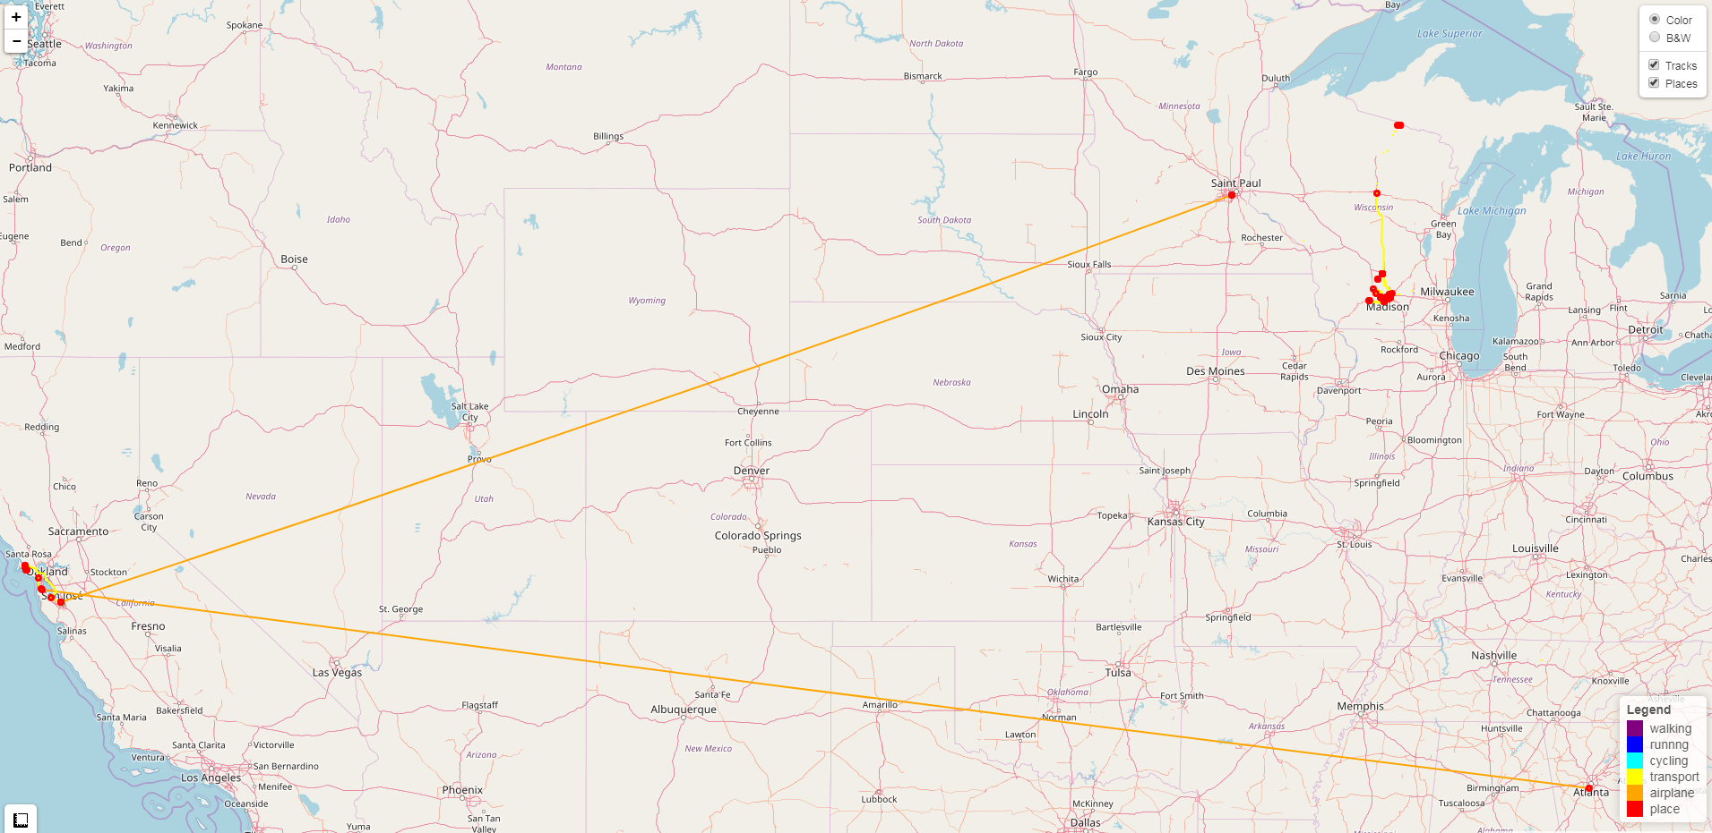
My GPS History
Notes:
Review my GPS logs – Jan/Feb, 2018
Trail running vacation in Marin headland in CA
XC trip up north (stops in Wausau for food)

Slide 32
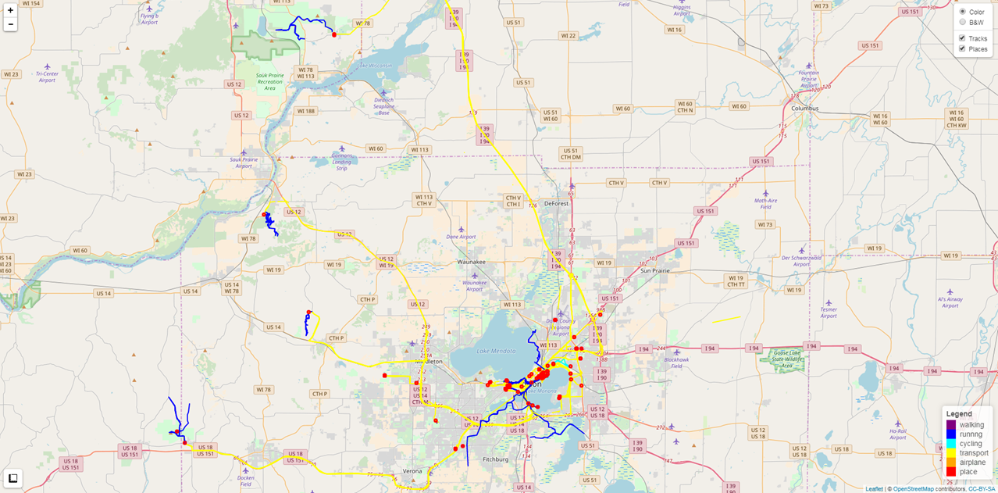
My GPS History
Notes:
Day trips outside of Madison
Weekend trail running in WI parks
Long runs outside of Madison

Slide 33
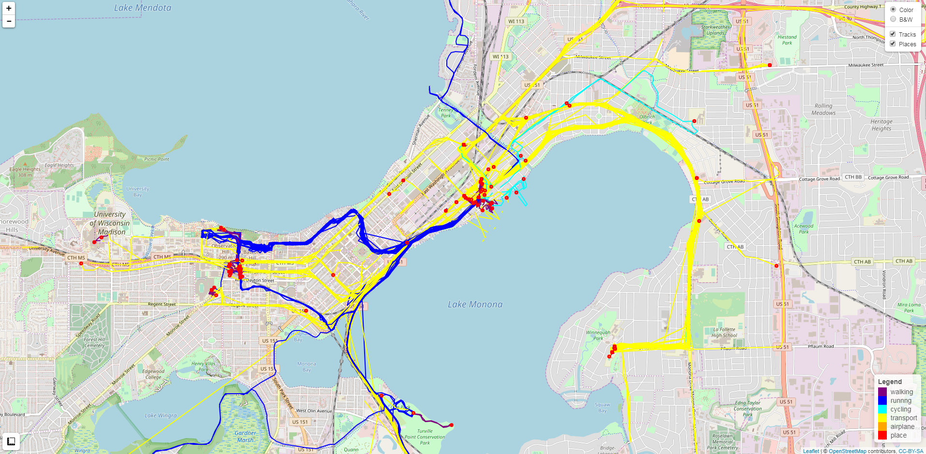
My GPS History
Notes:
Tracks & Places in Madison
Daily commute to Jake’s and Hana’s schools
Daily run commute to work
Coffee shops I like
Snow biking with Jake
Hiking with family

Slide 34
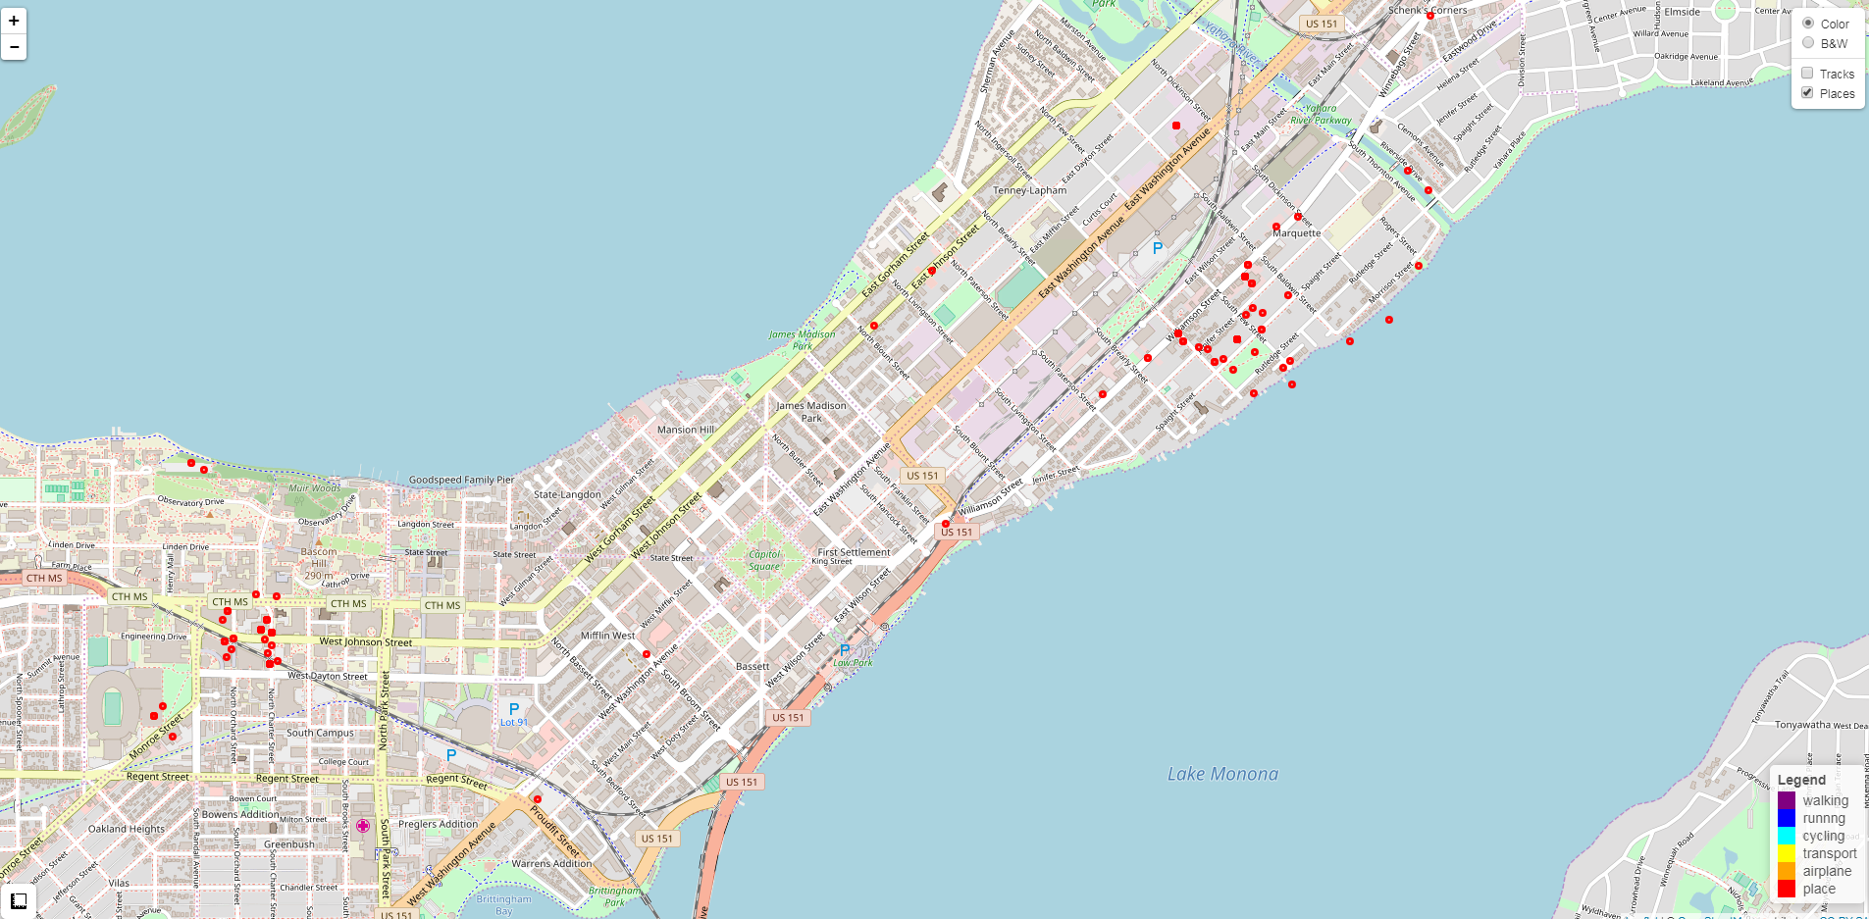
My GPS History

Slide 35
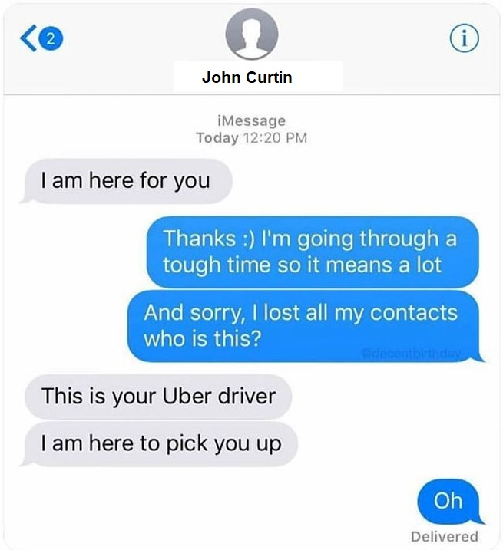
And you can imagine my smartphone communications.........

Slide 36
Our Intuition: Context is Critical
Within person change (all raw sensing data)
Contextualized GPS
Contextualized Voice and SMS Communication

Slide 37
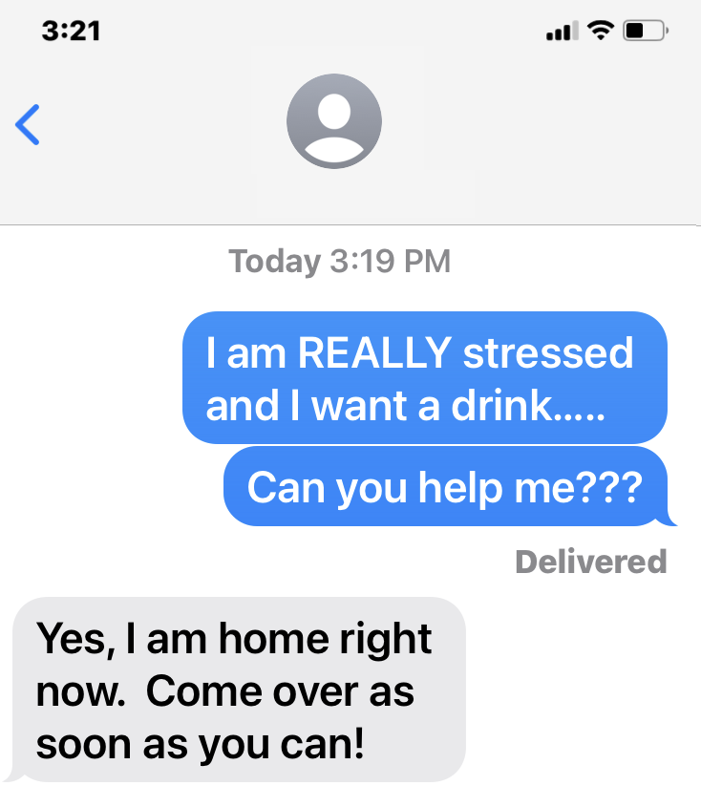
Context is Critical

Slide 38
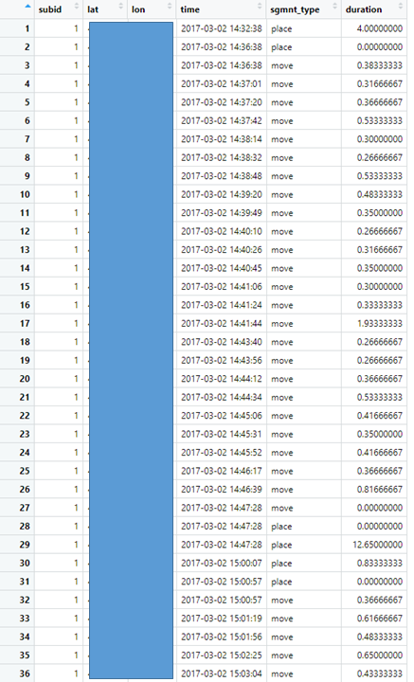
Contextualized GPS

Slide 39
Contextualized GPS
Type of Place:
 Home  Work
 Home of Friend  Home of Family Member
 Liquor Store  Coffee Shop/Cafe
 Restaurant  Park
 Bar  Gym/Fitness center
 AA/Recovery Meeting
Alcohol context:
 I’ve drank alcohol here before
 Alcohol is available here
This place is generally:
Pleasant Unpleasant Mixed Neutral
This place is :
High risk Moderate Risk Low risk No risk

Slide 40
Contextualized Voice and SMS
Have you drank alcohol with this person?
Never/Almost Never Occasionally Almost Always/Always
What is their drinking status?
Drinker Non-Drinker Don’t Know
Would you expect them to drink in your presence?
Yes Uncertain No
Are they currently in recovery from alcohol/other substances?
Yes No Don’t Know
Do they know about your recovery goals and if so are they supportive?
Don’t Know or Supportive Unsupportive Mixed Neutral
Are your experiences with this person typically…
Pleasant Unpleasant Mixed or Neutral?
Can link contacts context to location of homes of friends/family

Slide 41
Baseline Feature Engineering for GPS
Focus on recent past experiences (6, 12, 24, 48, 72, 168 hours)
Raw scores and change scores (from baseline)
Time spent at important places (e.g, alcohol present, drank at location in past, risky, unpleasant)

Slide 42
Contextualized GPS: 1 Day Window Duration
AUC = .70

Slide 43
Contextualized GPS: 1 Day Window Duration
Ground Truth
 | No Lapse | Lapse
No Lapse | 100,147 | 3,161
Lapse | 131,865 | 16,377
Model
Prediction
Sensitivity = 0.84
Specificity = 0.43
Balanced accuracy = .64
Positive predictive value = 0.11
Optimal threshold = .16

Slide 44
Next Steps
Much more feature engineering (number visits, patterning, interactions with date/day/time)
Beyond places to tracks
Passive detection of context
Public map data
Models that predict context
Combine with other data streams
Infrequent EMA (or EMA as needed)
Other passive data streams
Notes:
These models are already performance well above change for each of our two most passive data sources: Cellular and GPS. Most importantly, we have only scratched the surface so far with respect to extracting features/predictors for these two data sources. For example, we are not yet doing any natural language processing on the SMS content. We are also not using any track information from GPS (only places). These signals will become much more powerful once we more fully exploit them. Given this early performance I fully expect to be able to build models that perform well and use only these passive data sources

Slide 45
Baseline Feature Engineering for Communications Logs
Focus on recent past experiences (6, 12, 24, 48, 72, 168 hours)
Raw scores and change scores (from baseline)
Number of contacts and duration of contacts by context (e.g., supportive/unsupportive, drank past, drinker, recovery, pleasant)

Slide 46
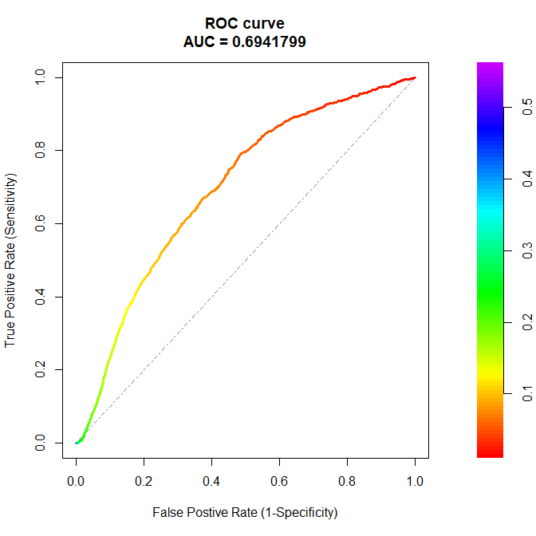
Communications Logs: 1 Day from Very Early Stages
More feature engineering (patterns of contacts, interactions with date/day, time)
NLP on message context!
Combine with GPS (and other data streams)
AUC = .69

Slide 47
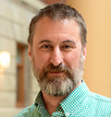
Active Project: Lapse in patients with Opioid Use Disorder
Recruiting 400 - 500 patients in recovery from Opioid Use Disorder
More variation in stage of recover (1 – 6 months at start)
12 months of monitoring
Closer to real implementation methods
National sample (size; diversity: demographics, location)
D. Shah (Co-PI)
D. Gustafson (Co-I)
X. Zhu (Co-I)
R. Brown (Co-I)
Q. Huang (Co-I)
B. Sethares (Co-I)

Slide 48
Next Projects
Determine most effective use of prediction signal with patients (and clinicians?)
Engagement and messages when low PPV?
More assertive when high PPV?
Good that models predict lapse, not relapse?
Use same system to recommend and adapt optimal supports and interventions to prevent lapses
Personal models
Can’t build person specific models (or at least from scratch)
Can build models for "people like you "
Opt in to combine preferred data streams

Slide 50
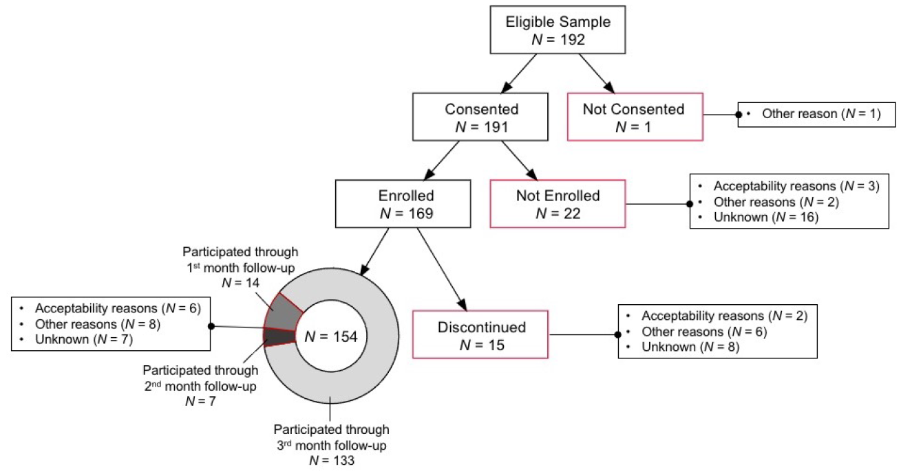
Personal Sensing Acceptability in SUD: Study Milestones

Slide 51
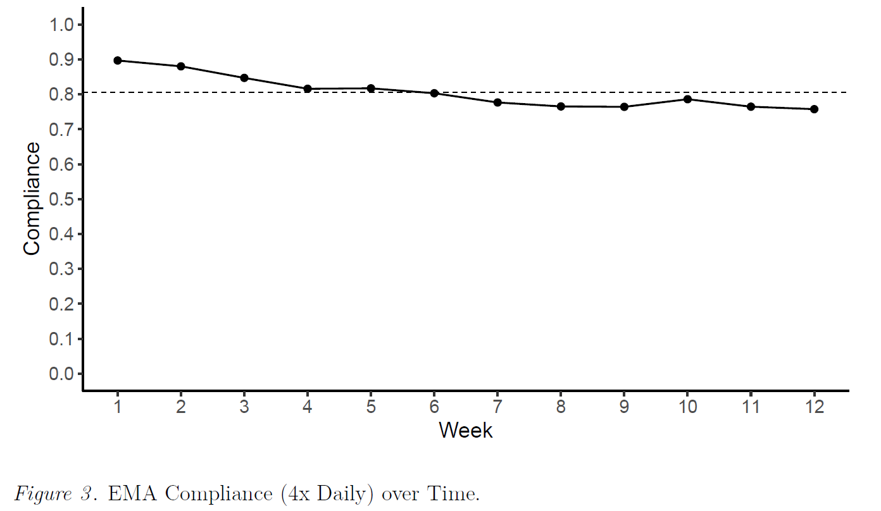
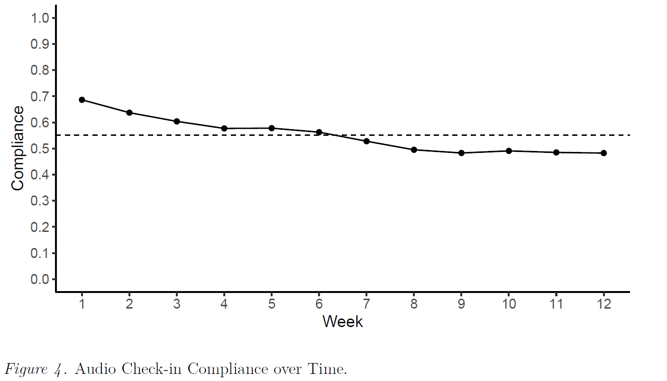
Personal Sensing Acceptability in SUD: Compliance
100% Opt in for GPS
100% Opt in for Communication Logs

Slide 52
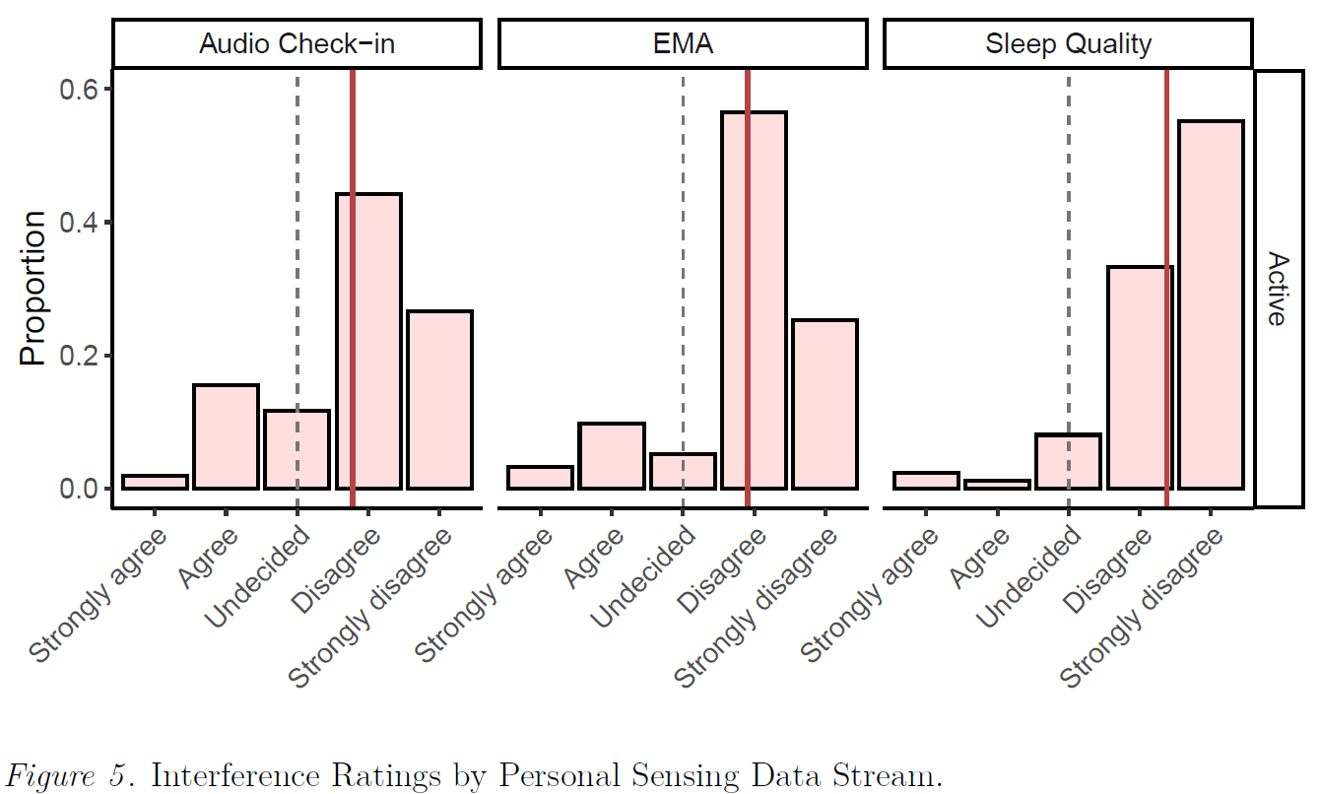
Personal Sensing Acceptability in SUD: Interference

Slide 53
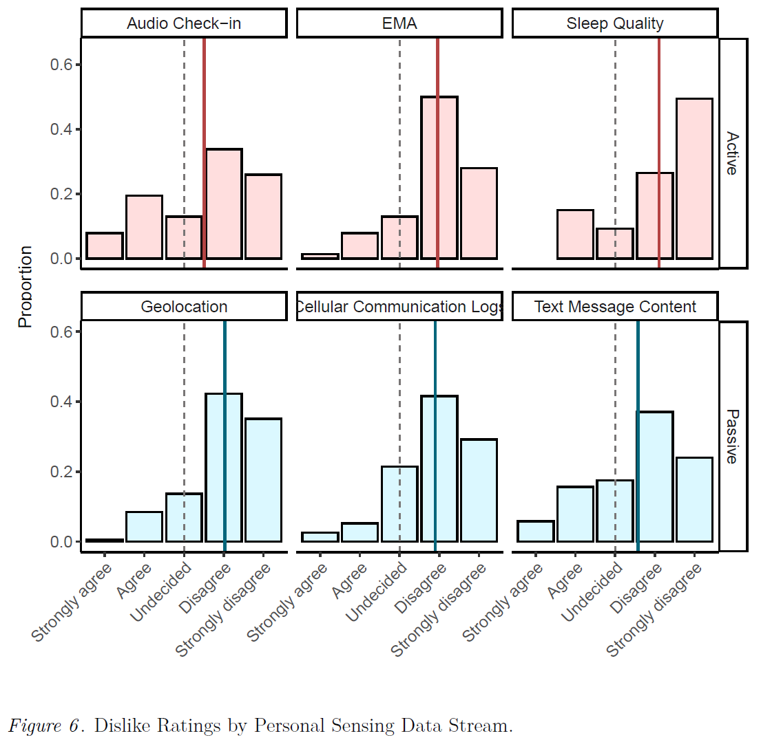
Personal Sensing Acceptability in SUD: Dislike

Slide 54
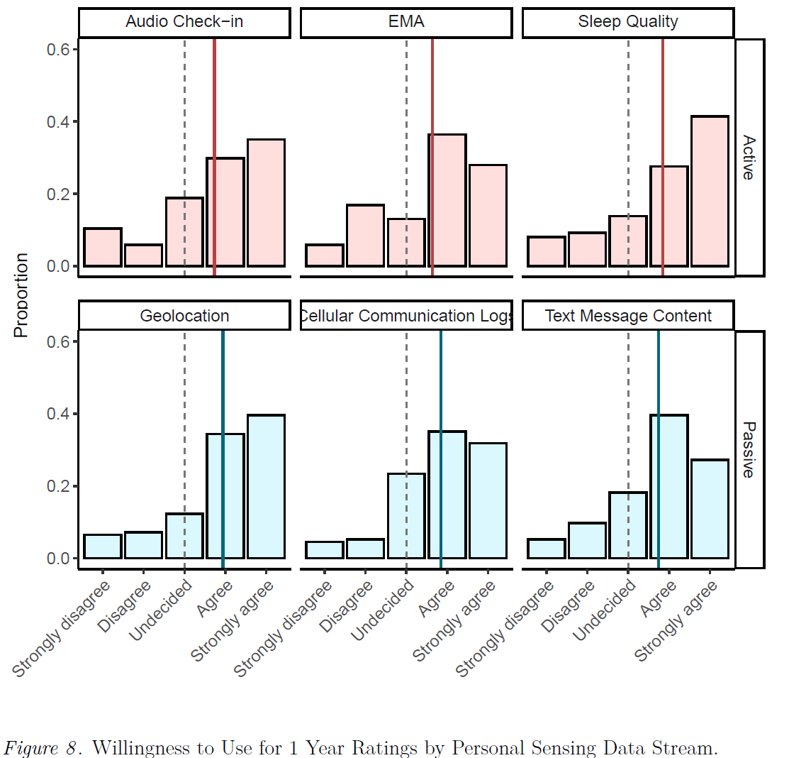
Personal Sensing Acceptability in SUD: Use for 1 year

