Slide 1

Psychometric properties of startle and corrugator response in NPU and affective picture viewing tasks
Jesse T. Kaye, Daniel E. Bradford, John J. Curtin
University of Wisconsin – Madison

Slide 2
Construct | Genes | Molecules | Cells | Circuits | Physiology | Behavior | Self-Report
Notes:
Earlier this year NIMH put out a Request for Information with the goal of “developing a well-specified list of tasks, paradigms, and measures for investigators to consider using to measure the constructs of the RDoC matrix”. Psychophysiological tasks may tap RDoC constructs at a level that can bridge critically between other units of analysis such as neural circuits, behavior and self-report. As such, they are attractively situated to index these dimensional individual difference constructs within the RDoC initiative.

Slide 3
Negative Valence System
Construct | Genes | Molecules | Cells | Circuits | Physiology | Behavior | Self-Report
Acute Threat (“Fear”) |  |  |  |  | X
Potential Threat (“Anxiety”) |  |  |  |  | X
Tasks
  No Shock, Predictable Shock, Unpredictable Shock (NPU)
  Affective Picture Viewing
Notes:
Today I will focus on two tasks that have been proposed as paradigms to study the Negative Valence System constructs of acute threat or “fear” and potential threat or “anxiety”. In particular I will look at the No Shock, Predictable Shock, Unpredictable Shock, or NPU Task and an Affective Picture Viewing Task.

Slide 4
Negative Valence System
Construct | Genes | Molecules | Cells | Circuits | Physiology | Behavior | Self-Report
Acute Threat (“Fear”) |  |  |  |  | X
Potential Threat (“Anxiety”) |  |  |  |  | X
Tasks
  No Shock, Predictable Shock, Unpredictable Shock (NPU)
  Affective Picture Viewing
Measures
  Startle
  Corrugator
Notes:
I’ll provide a comprehensive psychometric evaluation of two common facial EMG measures in these tasks. And I’ll argue that for these tasks to meaningfully contribute to the study of individual differences in the RDoC initiative they must possess sound psychometric properties.

Slide 5
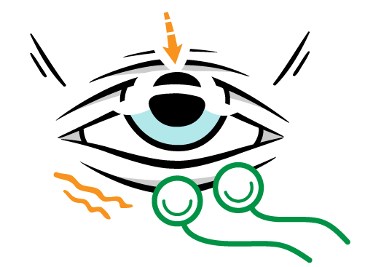
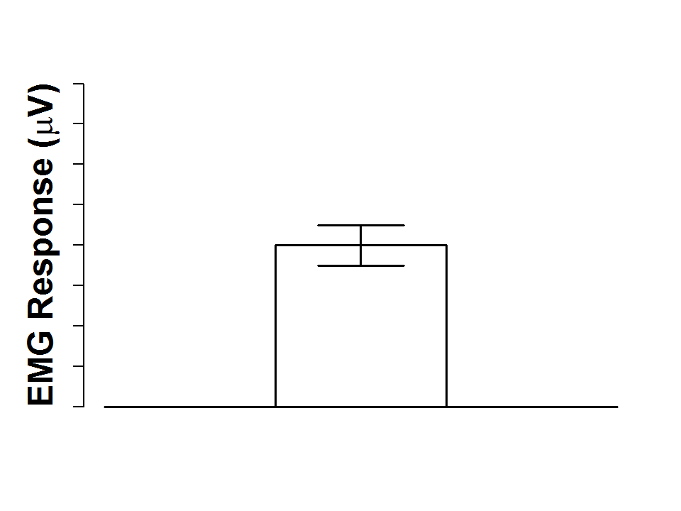
Corrugator Response
Startle Response
Notes:
The corrugator supercilii muscle around the eyebrow is activated by many negative affective facial expressions such as those expressed during fear, anger or disgust. The startle response is an adaptive defensive reflex, which we measure via the orbicularis occuli muscle to capture the vigor of the eyeblink startle. In our study we measure corrugator in response to the onset of an affective visual stimuli (such as a picture) and we measure the eyeblink response to startling white noise probes during that visual stimuli.

Slide 6
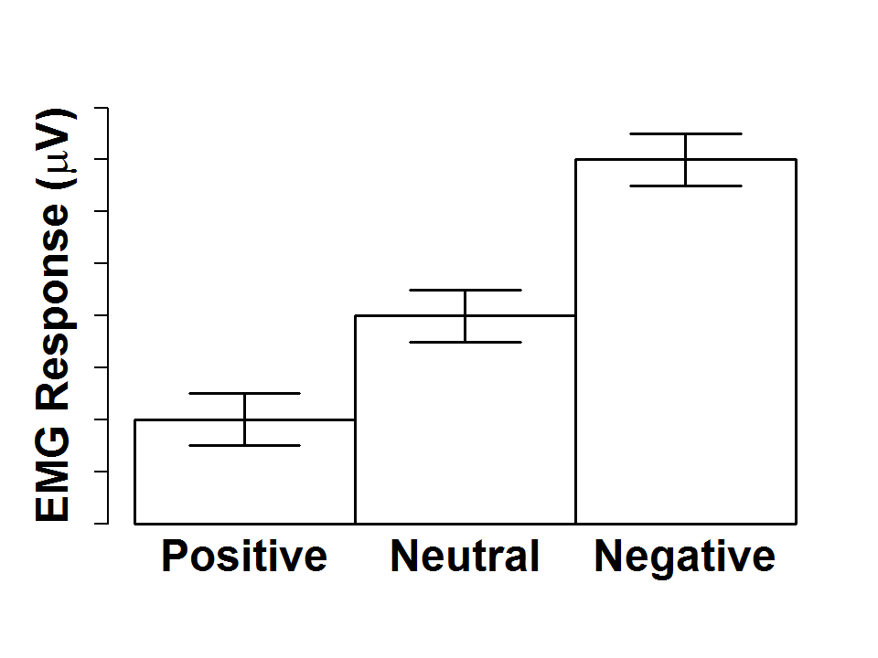
Corrugator Response
Startle Response
Notes:
A number of studies suggest that these responses are bidirectional. That is, relative to a neutral condition they are increased during negative affective states [POINT] and decreased during positive affective states [POINT]. The primary dependent variable in the experiment I will discuss today is this modulation or difference of the corrugator and startle response relative to a neutral condition.

Slide 7
NPU Task
= Electric Shock
Predictable Shock Block
Unpredictable Shock Block
Blocks of colored square “cues” (5s each) with a variable ITI
Cues occur in three different within-subject conditions
  Predictable Shock: Shocks during cues only
  Unpredictable Shock: Shocks at any time
  No Shock: No shocks at any time
Startle/corrugator modulation calculated separately for predictable and unpredictable vs. no-shock
Notes:
Now I’m going to describe the two tasks in our study. Predictable and unpredictable threat conditions in the NPU task have been proposed to map onto these RDoC constructs of acute and potential threat, respectively.
In the task, participants view 5 second presentations of colored cues with a variable inter-trial interval separating the cues. These cues are presented in different blocks:
In PREDICTABLE shock blocks (displayed in BLUE), participants are instructed that mild electric shocks will be administered at the end of every cue. In the UNPREDICTABLE shock blocks (displayed in RED), participants are instructed that shocks can be administered AT ANY TIME during the cues or the intervals between cues. In NO shock blocks, not displayed for simplicity, participants can never be shocked.
We measure corrugator and startle responses during these predictable and unpredictable threat cues and calculate how much it is increased relative to the no shock cues.

Slide 8



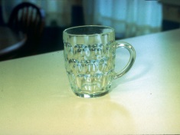


Affective Picture Viewing Task
International Affective Picture System (IAPS) valence conditions:
  Unpleasant
  Pleasant
  Neutral
Pictures (6s) intermixed & counterbalanced by valence within-subjects
Startle/corrugator modulation calculated separately for pleasant and unpleasant vs. neutral
Notes:
The International Affective Picture System, or IAPS for short, was developed to provide a standardized set of pictures including unpleasant, pleasant, and neutral pictures. The IAPS have been widely used in psychophysiology research, predating the RDoC by several decades. The RDoC website lists viewing aversive pictures as one potential paradigm for measuring the acute threat or “fear” construct. It’s not quite as clear where exactly viewing pleasant pictures fits in the current formulation of the RDoC matrix, presumably somewhere in the Positive Valence system.
In our experiment, which I’ll refer to as the IAPS task, participants view pictures for 6 seconds with a variable ITI. Pictures valence is intermixed and counterbalanced within subjects. We calculate startle and corrugator modulation separately for pleasant and unpleasant pictures relative to neutral pictures.

Slide 9
N: 128
Study visits: 2
Separation: 1 week
Quantification: Raw microvolts (time domain)
Notes:
In our study 128 participants came into the lab twice about one week apart. At each visit they completed both the NPU and IAPS tasks. Since both tasks have a variety of iterations and we tried to implement what we considered to be a fairly typical experimental design. Today I will present startle and corrugator data both quantified as raw microvolt scores in the time domain.

Slide 10
Notes:
We examined three psychometric properties because of their implications for the robustness, reproducibility, and reliability of psychological research using these tasks.

Slide 11
Effect size and stability
Notes:
Information about the effect size and stability of these task manipulations is important to avoid pitfalls (such as ceiling or floor effects) and to interpret change over time between sessions.

Slide 12
Effect size and stability
Internal consistency (split-half reliability)
Notes:
We examined split-half reliability using Spearman-brown corrected correlations between odd and even trials to quantify the internal consistency within subjects. This is important to the extent that the measure is conceptualized as representing a unidimensional construct that’s measured homogenously by multiple trials or items.

Slide 13
Effect size and stability
Internal consistency (split-half reliability)
Temporal stability (test-retest reliability)
Notes:
We examine temporal stability using Pearson correlations between study visit 1 and visit 2 to quantify the stability of individual differences in responses over one week. Temporal stability is an essential prerequisite for any studies aiming to make inferences about trait-like characteristics, repeat task administration within subjects under different conditions, or detect change over time.

Slide 14
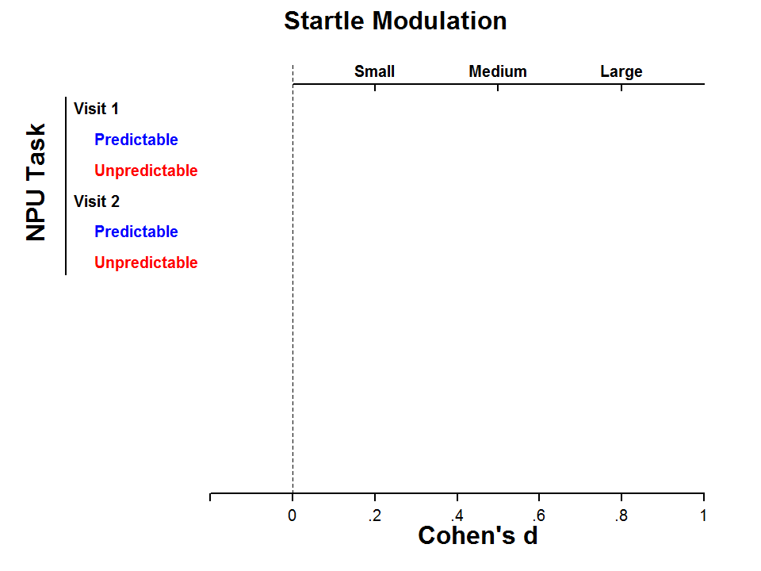
Notes:
First we’ll look at the effect size magnitude and stability of startle modulation. Cohen’s D is on the X-axis. To help anchor these we have traditional values on top identifying small, medium or large effect sizes of .2, .5. and .8 respectively.
For the NPU task the predictable shock is displayed in blue and the unpredictable shock in red. I will use this general format and coloring for all of the data slides.

Slide 15
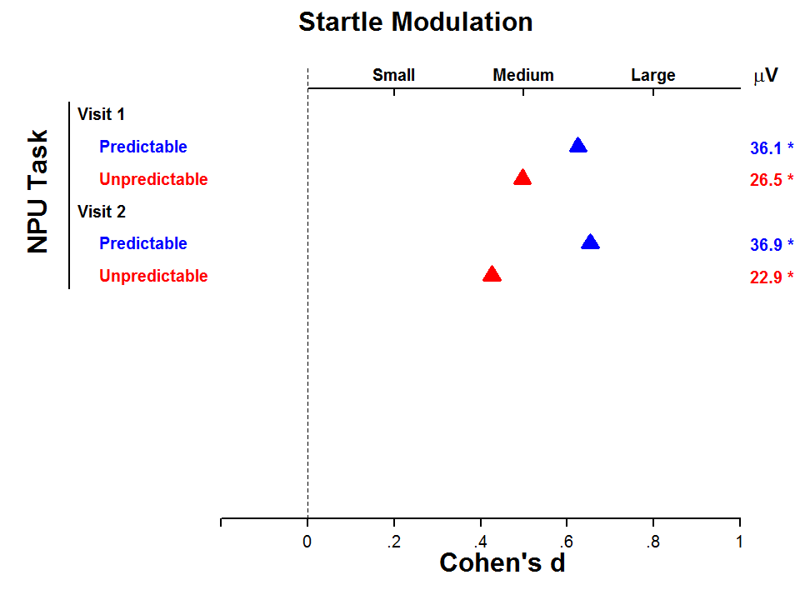
Notes:
At both study visit 1 [on top] and 2 [below] predictable and unpredictable threat of shock elicited robust startle modulation. The effect size was consistently in the .4-.7 range. For those startle researchers in the audience who prefer to think in terms of raw units you can see on the right that startle was potentiated about 25 to 35 microvolts. Asterisks to the right indicate whether the effect was significant. The magnitude of predictable startle modulation on average was stable across study visits, but there was a small but significant decrease to unpredictable threat from time 1 to 2.

Slide 16
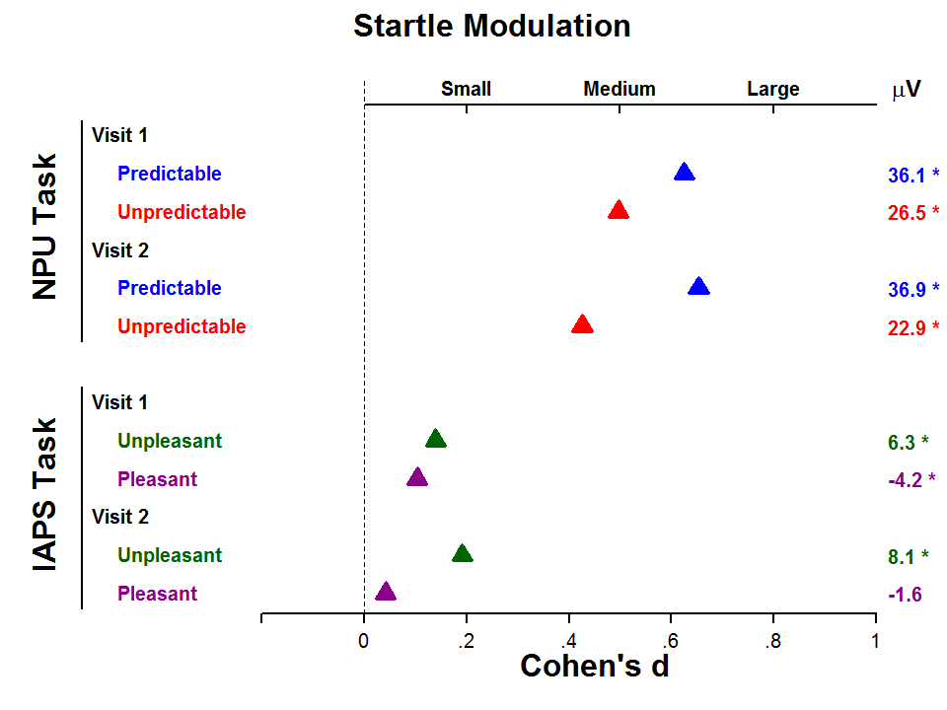
Notes:
For the IAPS task, unpleasant pictures are displayed in green and pleasant pictures in purple.
We observed the classic emotion modulated startle effect at study visit 1. Unpleasant pictures significantly increased startle and pleasant pictures decreased startle relative to neutral pictures. Cohen’s d’s are plotted as absolute values for display purposes, so pleasant attenuation appears positive. The unpleasant startle effect was significant and stable across study visits, but the pleasant picture effect disappeared by the second visit. This is consistent with earlier findings from Manber, Allen and colleagues over 15 years ago and highlights ongoing concerns for study designs with repeated testing aiming to examine startle modulation by pleasant pictures.

Slide 17
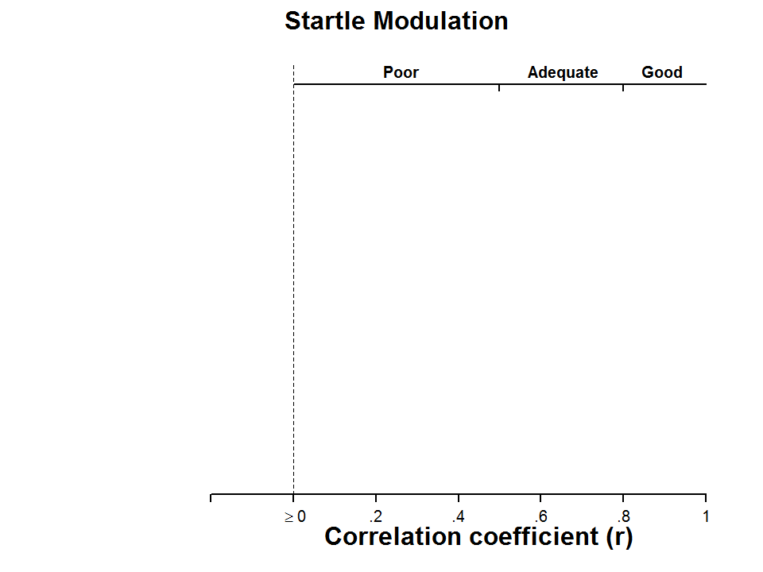
Notes:
Staying with startle modulation we’ll now turn to internal consistency and temporal stability. The X-axis has changed and is now the Pearson correlation coefficient.

Slide 18
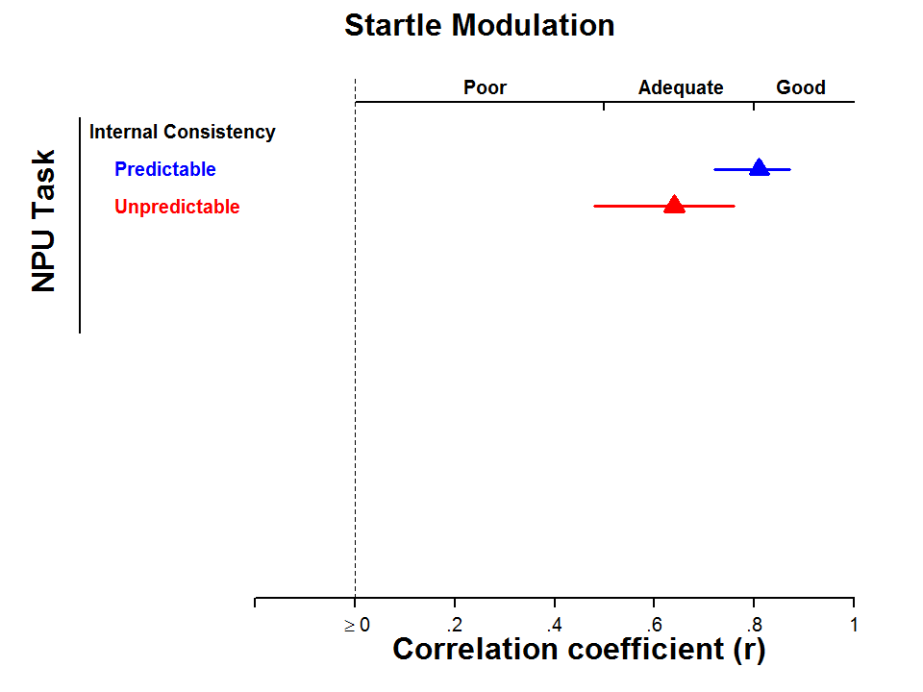
Notes:
In the NPU Task startle modulation displays adequate to good internal consistency, with correlations in the .6 to .8 range. The lines represent 95% confidence intervals.

Slide 19
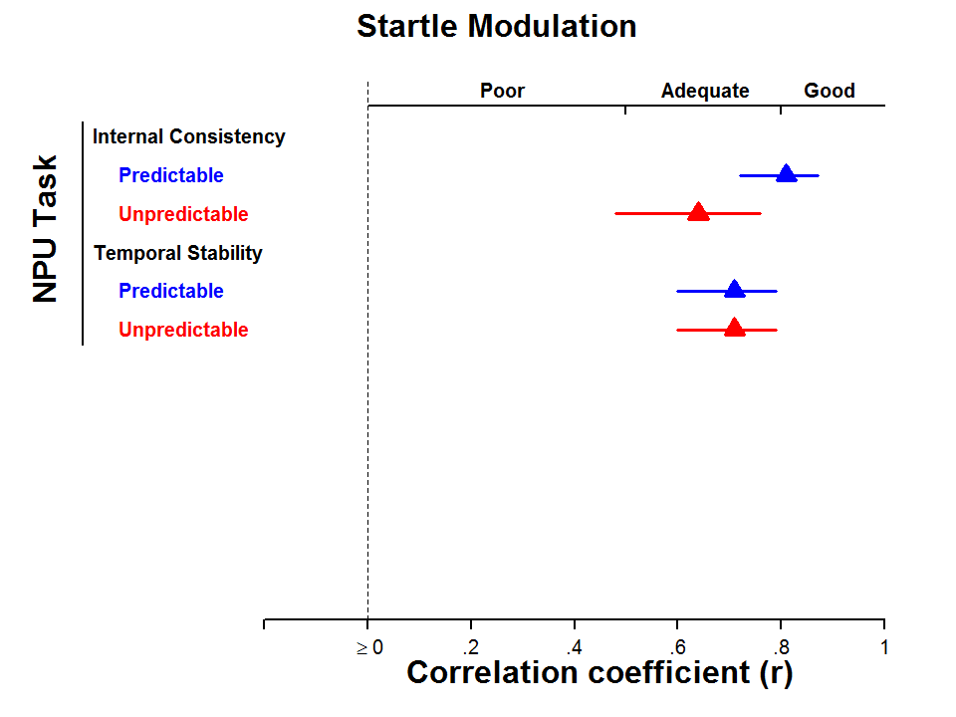
Notes:
We observed the temporal stability of predictable and unpredictable startle modulation to be appropriate for repeated measurement over time with correlations between visit 1 & 2 around 0.7. These results closely align with a previous study from Stew Shankman’s lab.

Slide 20
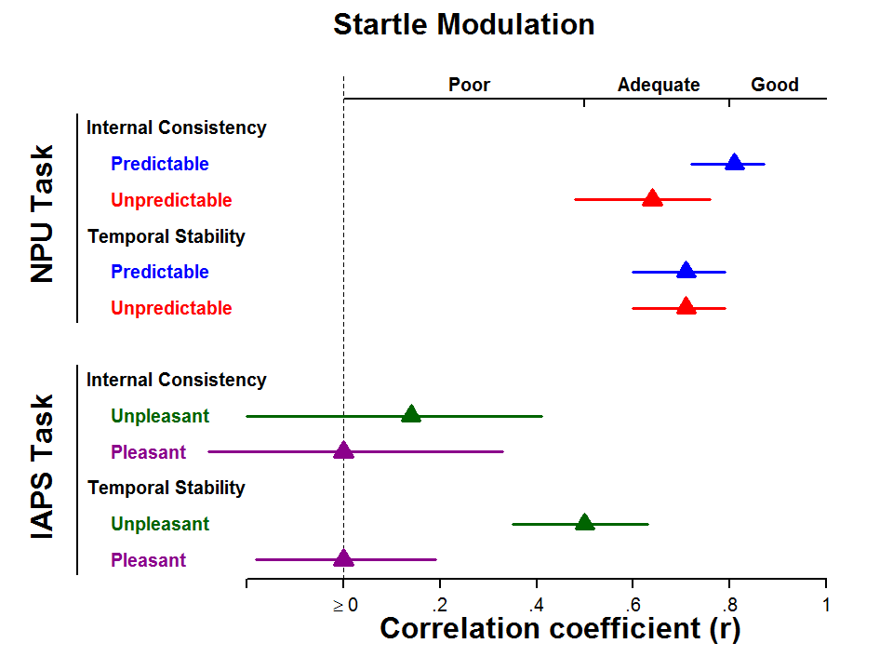
Notes:
We observed poor internal consistency for both pleasant and unpleasant picture startle modulation. As you can see both correlations were small and non-significant.
The temporal stability of unpleasant modulation was moderate with a correlation of .50, similar to previous studies by Chris Larson and colleagues. However, temporal stability of pleasant startle modulation was zero.
Two brief observations.

Slide 21
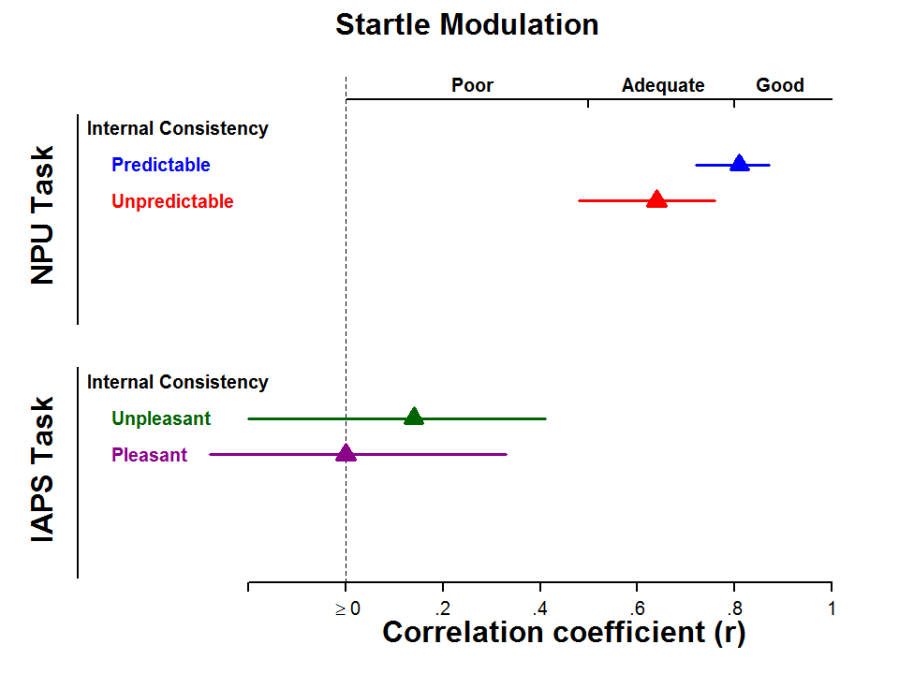
Notes:
First, the internal consistency of startle within the NPU was substantially higher than to IAPS pictures. This may not be surprising given that shock threat is essentially identical on every trial within a condition but picture content is highly variable within picture valence.

Slide 22
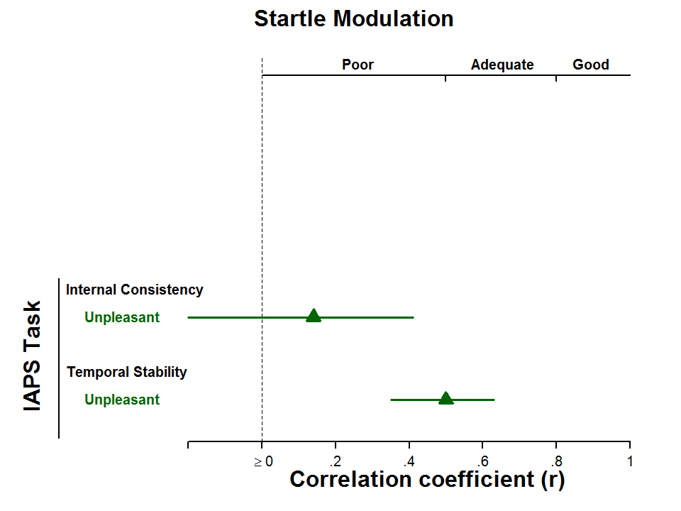
Notes:
This fairly common approach to selecting pictures within a valence condition to sample broadly across the range of affective content can lead to both no internal consistency, but moderate temporal stability. This likely occurs if a small subset of pictures produce responses that are stable over time, and have high variance between subjects. When effects may depend on the specific pictures selected for a particular study, issues of replicability become paramount when using this task-measure pairing to study group or individual differences.

Slide 23
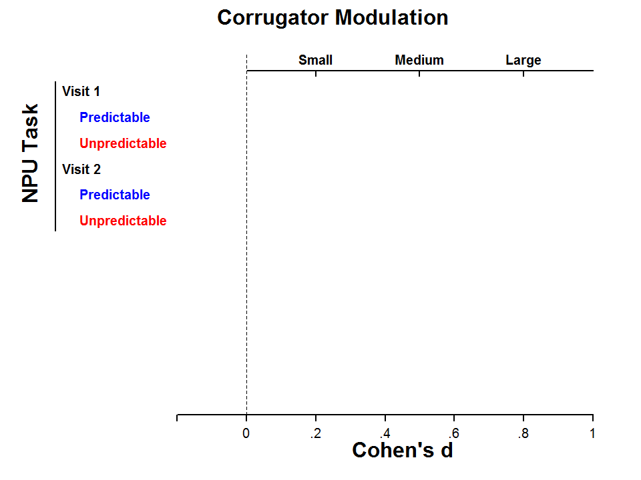
Notes:
That’s all the startle data and now we’ll transition to corrugator data. The format will be the same as startle. Starting with Effect Size Magnitude we have Cohen’s D on the X-axis again.

Slide 24
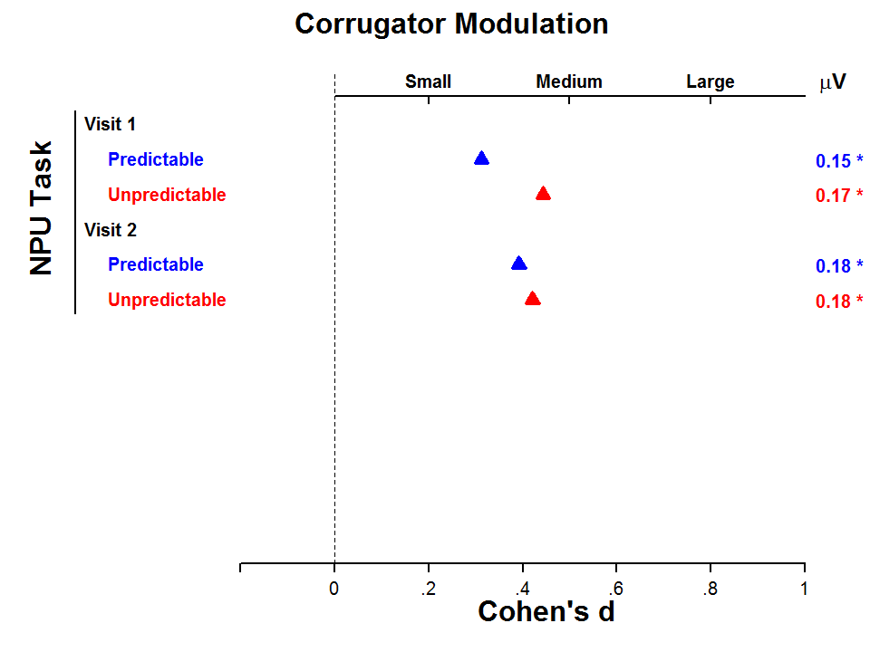
Notes:
In the NPU task, we found that corrugator was sensitive to threat of shock and significantly potentiated during both conditions. The effect sizes were stable across days, but somewhat smaller than startle in this task.

Slide 25
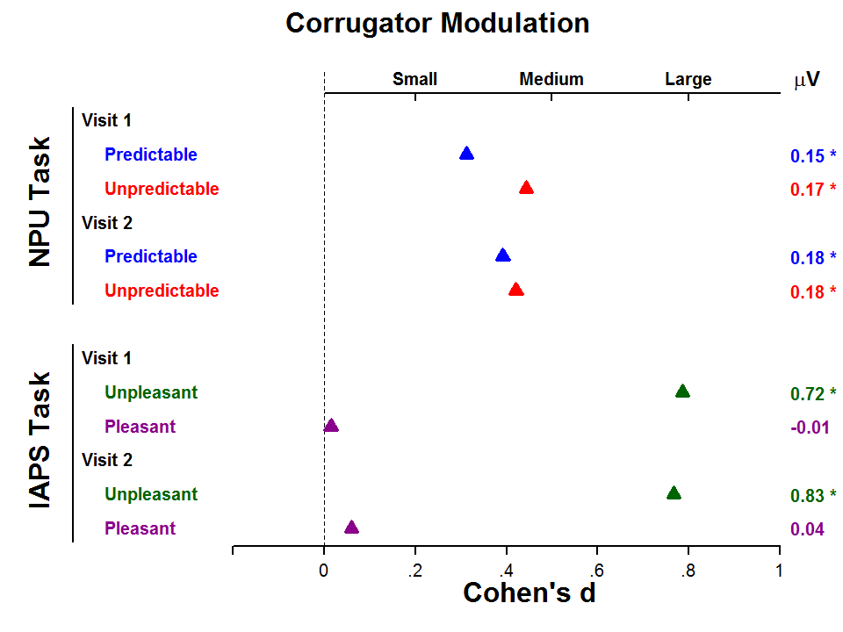
Notes:
Corrugator modulation to unpleasant pictures in green displayed large and stable effect sizes across both study visits. In contrast, pleasant pictures failed to elicit any corrugator modulation at either study visit.

Slide 26
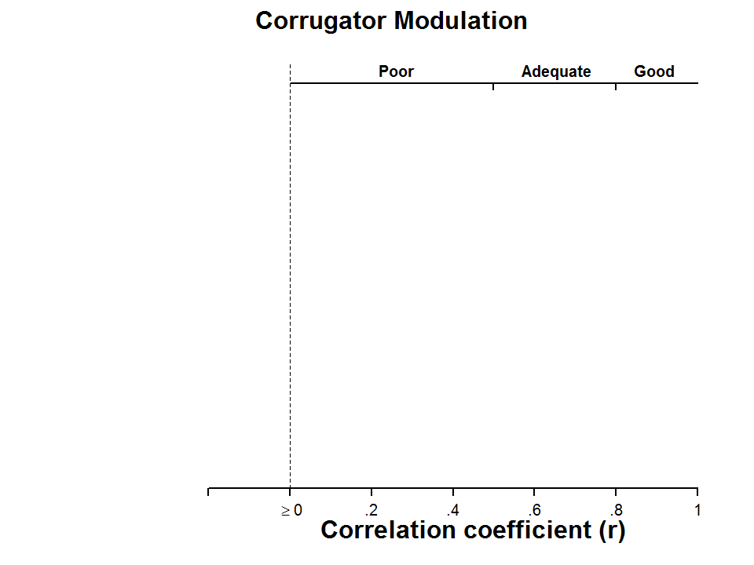
Notes:
Now to internal consistency and temporal stability. Again note the X-axis is now correlation coefficients.

Slide 27
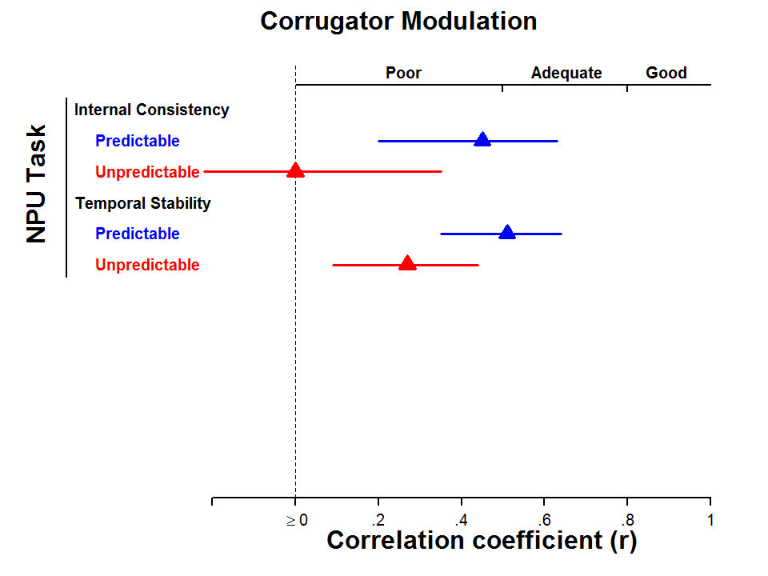
Notes:
Corrugator modulation to predictable shock displayed inadequate internal consistency and temporal stability hovering around .5. Corrugator modulation to unpredictable shock displayed worse psychometrics, raising concerns for this measure in the NPU task, at least with our current quantification approach.

Slide 28
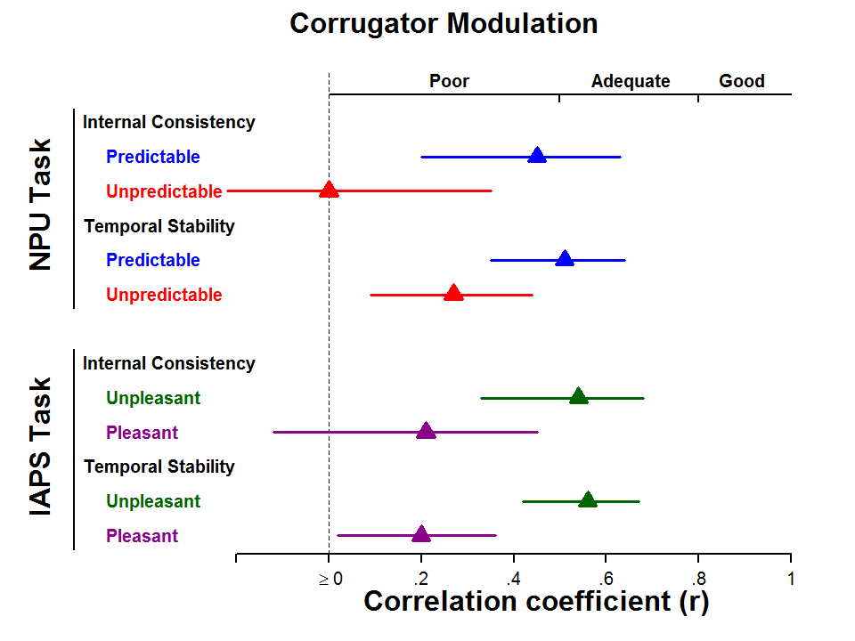
Notes:
Unpleasant picture corrugator modulation displayed significant internal consistency (r = .54) and temporal stability (r = .56) with correlations between .5 and .6.
In contrast, there are serious concerns about corrugator modulation to pleasant pictures, with no internal consistency and poor temporal stability.

Slide 29
Notes:
However, with many wide confidence intervals spanning the range that we might consider to be either poor or adequate, these correlation coefficients across both tasks clearly warrant cautious interpretation.

Slide 30
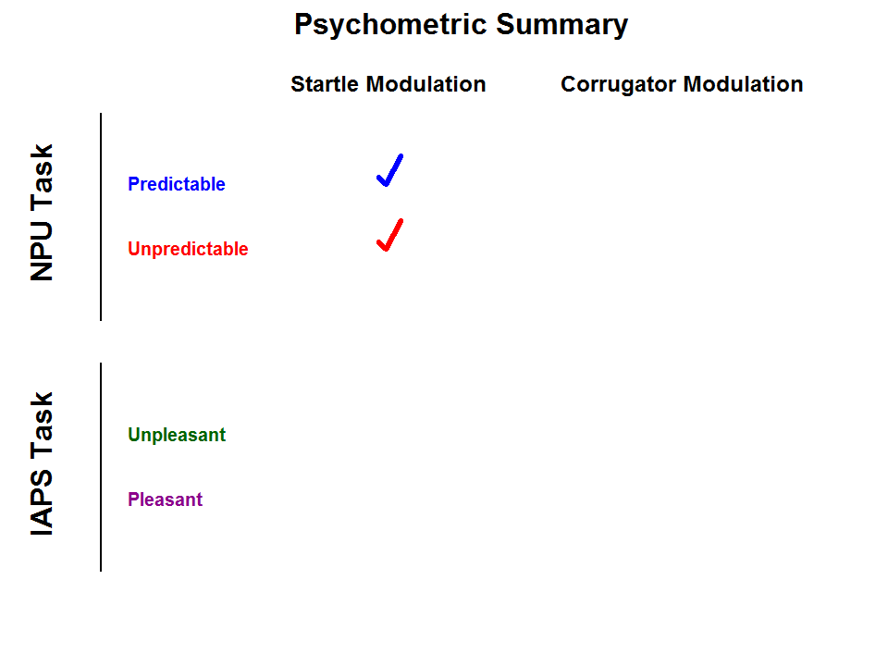
Notes:
So how did each measure perform overall within each task.
Startle potentiation to predictable and unpredictable threat of shock displayed reasonable psychometric properties overall. There is certainly room for improvement, but in general this task-measure pairing appears to be well matched.

Slide 31
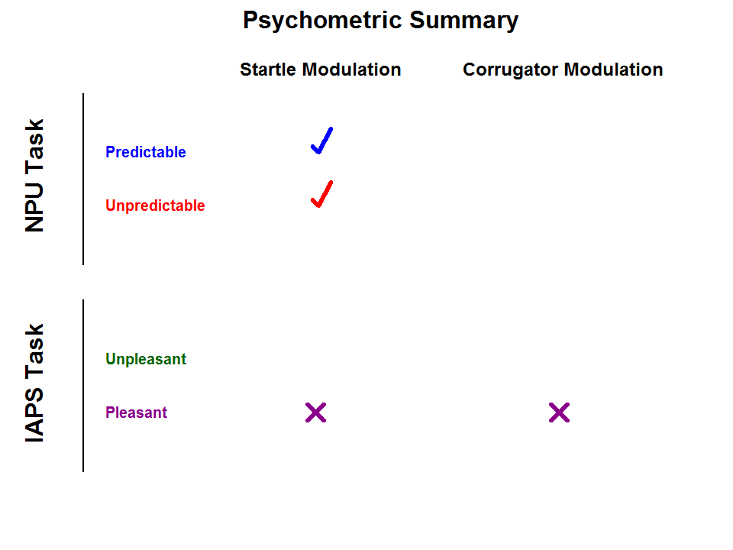
Notes:
Both startle and corrugator modulation to pleasant pictures displayed poor psychometric properties across the board. Other physiology measures may be more sensitive and reliable measures of affective processes to pleasant pictures (for example, postauricular reflex or certain ERP components), but our study raises concerns about the reliability of startle and corrugator with these stimuli.

Slide 32
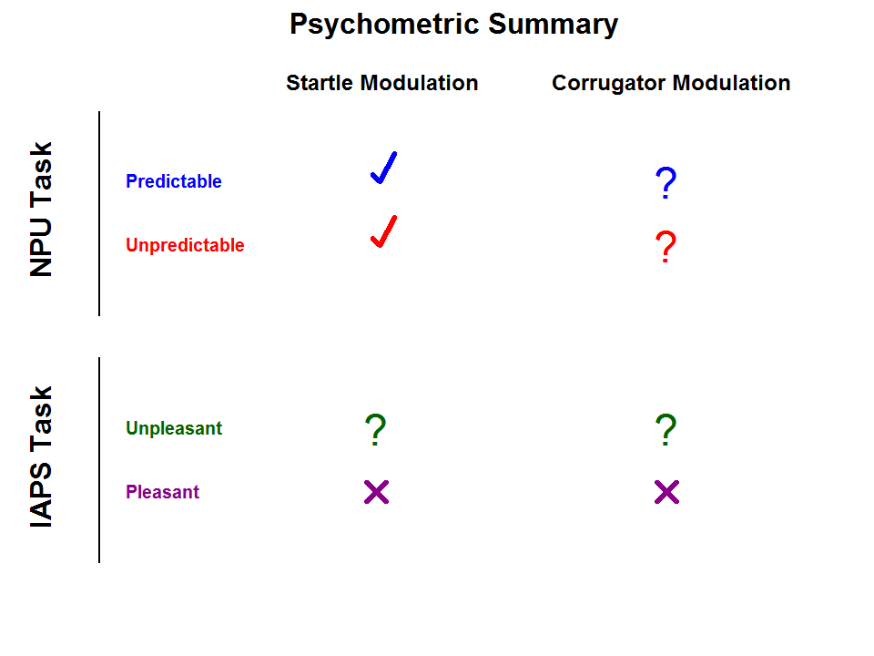
Notes:
The other task-measure pairings all displayed a mix of acceptable and inadequate psychometric properties. Of course, these conclusions are limited to experimental design implemented in our study. Future research may help elucidate the conditions under which the reliability of these task-measure pairings may be improved.

Slide 33
Psychophysiology tasks can contribute to RDoC, if…
More large studies on reliability
Cross-lab collaborations
Empirical recommendations for method & quantification
Notes:
The NIMH aims to develop a set of well-validated tasks that researchers can use to investigate specific constructs throughout the RDoC matrix. Psychophysiology tasks have a lot to contribute to the study of individual differences within this framework. However, if we hope to produce a literature that is robust, reliable, and reproducible, it is essential that our experimental tasks reflect those values. Psychometric studies usually don’t make flashy headlines or publications in Nature, but they are the bedrock of a solid science. If RDoC is to meaningfully advance clinical science, and not just be another instantiation of the replicability crisis facing psychology today, we need more studies of task reliability. Our study illustrates several issues that apply not just to these tasks, but provide an example for future efforts to optimize experimental tasks across the RDoC matrix.
First, we need larger psychometric studies. The reliability estimates I presented today were in many cases surrounded by quite large confidence intervals. Though our sample of 128 was larger than many previous psychometric studies of these tasks, frankly our study was not large enough. When internal consistency confidence intervals span from below .5 to above .8, how do we decide if this measure is acceptable. We need larger samples to increase the precision of our estimate of the true population values of reliability.
One promising avenue forward is to foster cross-lab collaborations to not only increase sample size, but address a number of other methodological issues that vary among labs. For instance, I presented data today quantified as raw microvolts in the time domain. However, it is also quite common to analyze startle as standardized t-scores, or corrugator in the frequency domain. Though I did not have time to discuss those analysis, we looked at both of those quantification approaches and the results were generally comparable, with some exception. These are just a few of the many quantification choices on the menu for researchers and it is likely that the reliability of all options are not the same. We need empirical studies to arbitrate between these types of method and quantification choices to facilitate integration of findings with a task across the literature.

Slide 34

Kaye JT, Bradford DE & Curtin JJ (2016). Psychometric properties of startle and corrugator response in NPU, Affective Picture Viewing, and Resting State tasks. Psychophysiology, 53(8), 1241-1255.
https://osf.io/fdjg9/
Notes:
You can find more details on this study in our paper just out in last month’s issue of Psychophysiology. All data and analysis code is publicly available online at the Open Science Framework.

Slide 35
Kaye JT, Bradford DE & Curtin JJ (2016). Psychometric properties of startle and corrugator response in NPU, Affective Picture Viewing, and Resting State tasks. Psychophysiology, 53(8), 1241-1255.
https://osf.io/fdjg9/
F31 AA022845
R01 AA024388
DGE 0718123
Research Team
John Curtin, Daniel Bradford, Charles Rohrer, Austin Kayser, Susan Schneck, Rachel Hamilton, Rachel Korhumel
Bradford DE, Kaye JT & Curtin JJ. The relationships among multiple psychophysiological and self-report measures of negative affect indexed across multiple tasks within the same sample. Poster #4-46
Notes:
Finally, I would like to thank the NIH and NSF for funding my research. My collaborators Daniel Bradford and John Curtin and the rest of our research team. If you are interested in hearing about the inter-task & inter-measure relationships within our study please stop by Daniel’s poster on Saturday.
[next slide]

Slide 36
Kaye JT, Bradford DE & Curtin JJ (2016). Psychometric properties of startle and corrugator response in NPU, Affective Picture Viewing, and Resting State tasks. Psychophysiology, 53(8), 1241-1255.
https://osf.io/fdjg9/
Notes:
Thank you for your attention.
We have time for a couple questions.

Slide 37
ADDITIONAL SLIDES

Slide 38
Effect Size
X-Axis Microvolts

Slide 39
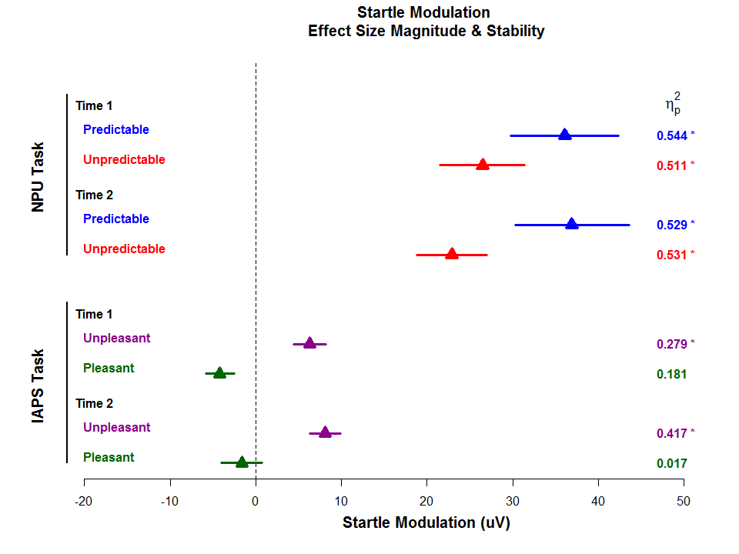
Notes:
Startle Modulation as microvolt units.
Partial eta squared in margin

Slide 40
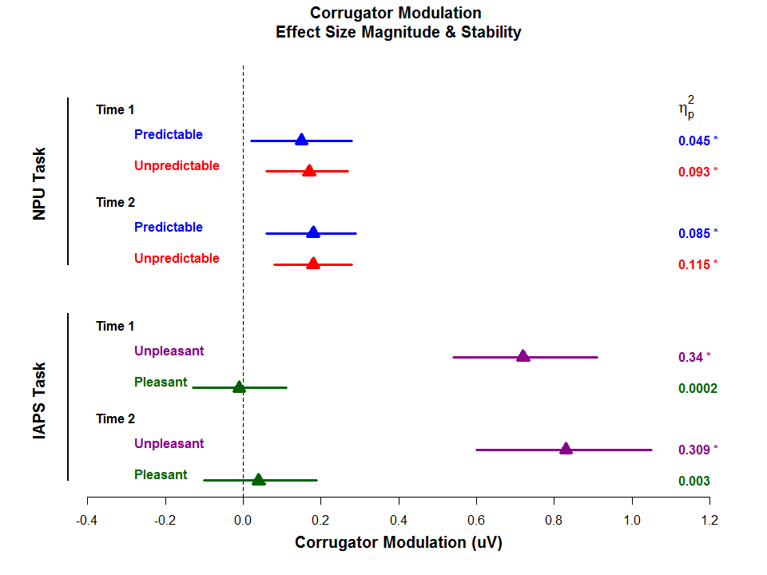
Notes:
Corrugator modulation as microvolts.
Partial eta squared in margin

Slide 41
Effect Size
Cohen’s Dz (within-sub)
Notes:
Cohen’s Dz

Slide 42
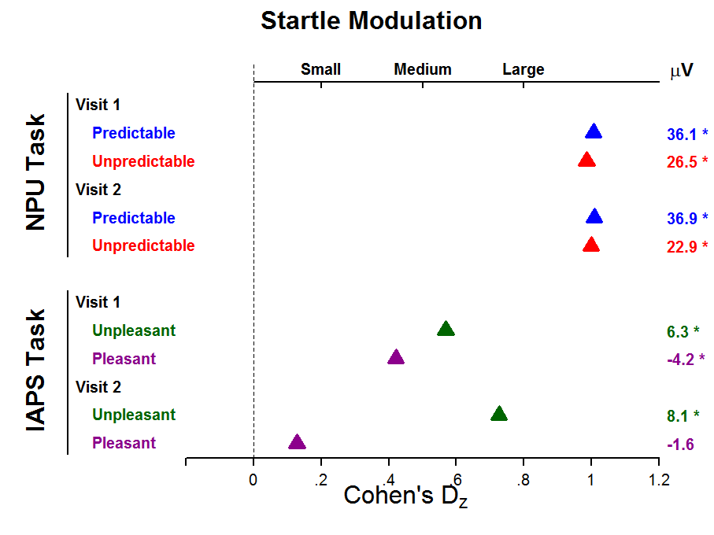
Notes:
Cohen’s Dz (within-sub): Standardized difference score
Numerator is the same (mean difference between conditions, aka startle potentiation)
Denominator = SD(Threat – No Threat)
Differs from normal cohen’s D, where denominator is the pooled standard deviation (aka square root of average variance in each condition).
Adjective Labels don’t really apply the same. Cohen was referring to D, not Dz with these labels. Regardless, “small, medium, large” adjectives should be used very cautiously anyway.

Slide 43
Internal Consistency
Temporal Stability
Startle: Raw vs. T-scores
Corrugator: Time vs. Frequency

Slide 44
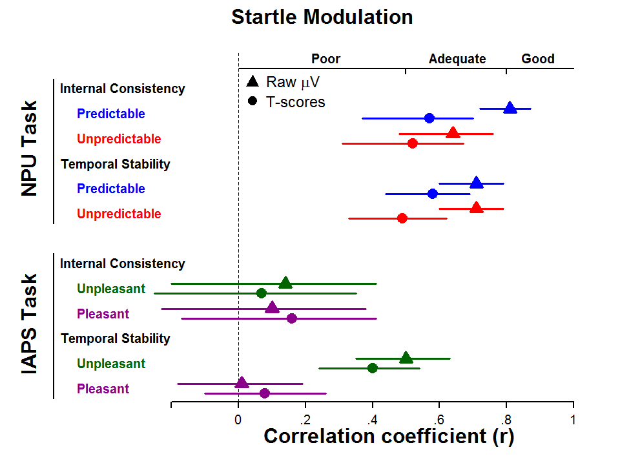
Notes:
Startle Modulation
Internal Consistency & Temporal Stability
Raw vs. t-scores
Very similar. Raw scores slightly better on average.

Slide 45
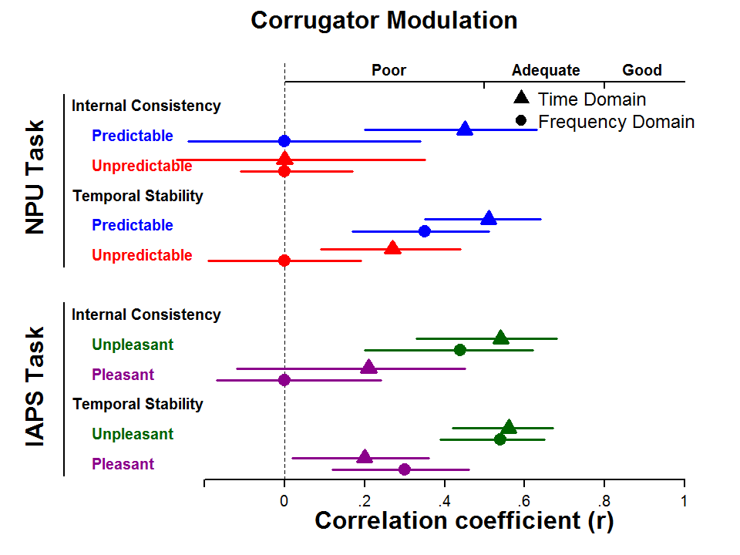
Notes:
Corrugator Modulation
Internal Consistency & Temporal Stability
Time vs. Frequency Domain
NOTE: correlations <0 are plotted at 0. Some where actually negative, which is basically meaningless for internal consistency

Slide 46
CONDITION SCORES
STARTLE

Slide 47
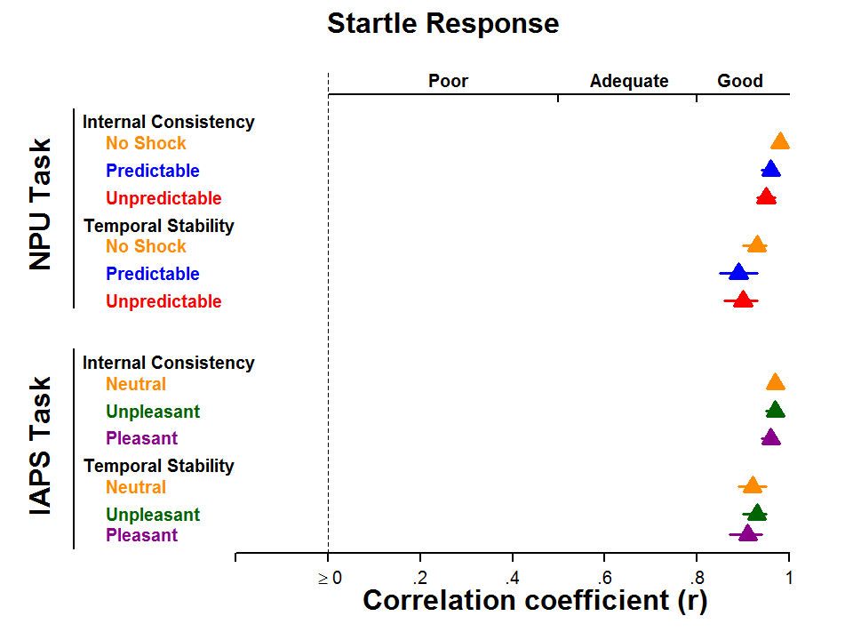
Notes:
Raw startle condition scores

Slide 48
CONDITION SCORES
CORRUGATOR

Slide 49
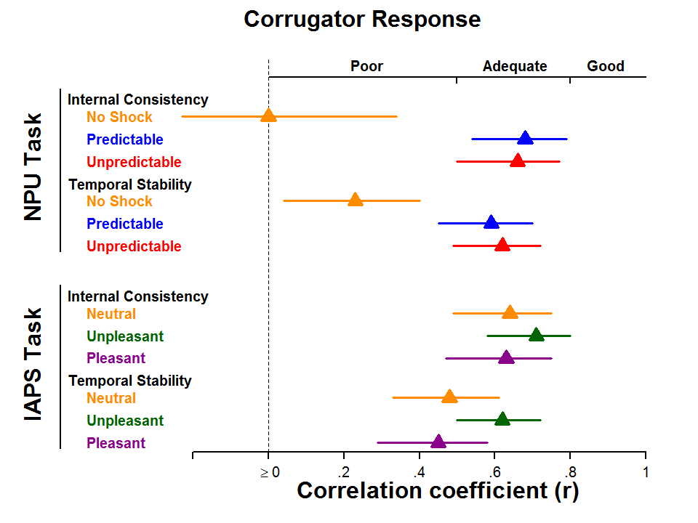
Notes:
Corrugator Time Domain Condition

Slide 50
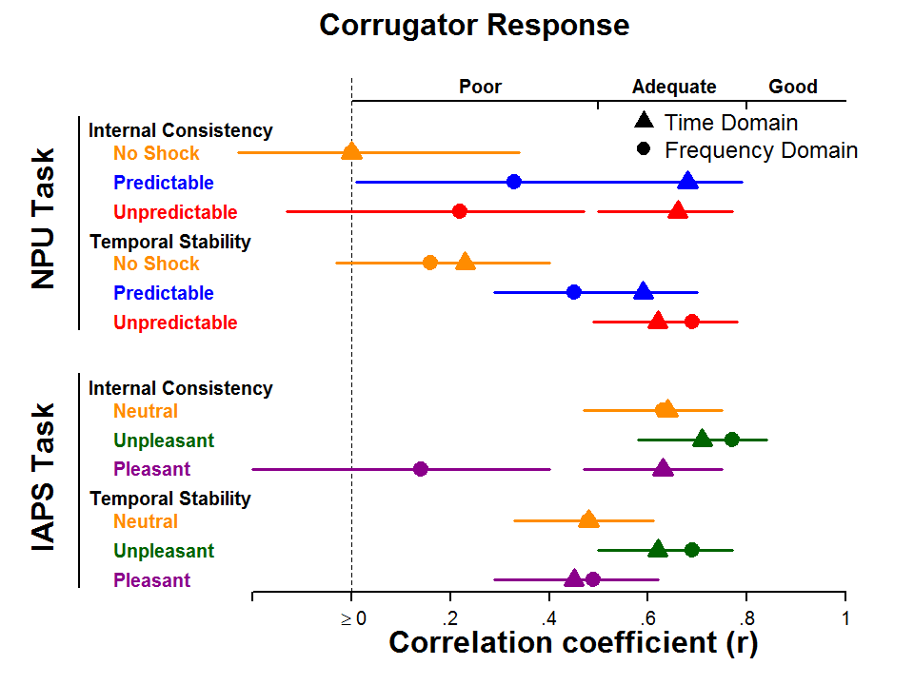
Notes:
Corrugator Condition Scores
Time vs Frequency

Slide 51
General Startle Reactivity

Slide 52
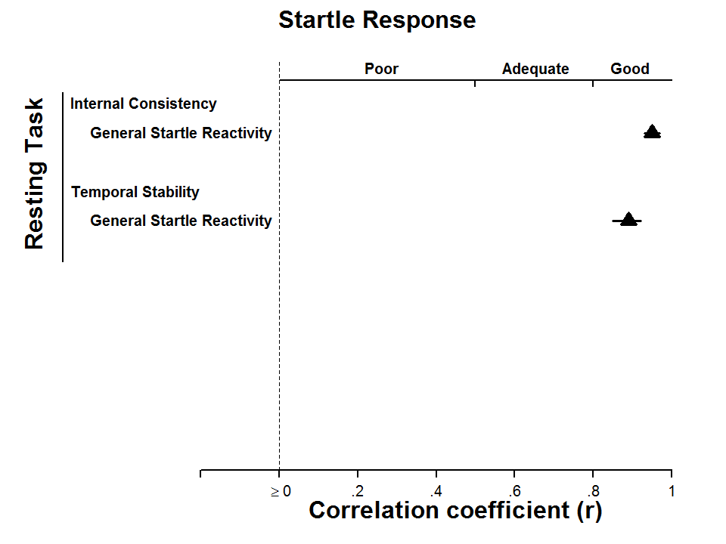
Notes:
Resting State Task (aka baseline startle)
General Startle Reactivity
Internal Consistency & Temporal Stability

Slide 53
Inter-task & Inter-measure

Slide 54
Inter-task & Inter-measure relationships
 |  |  | NPU |  |  |  | IAPS
 |  |  | Startle |  | Corrugator |  | Startle | Corrugator
 |  |  | U | P | U | P | U | U
NPU | Startle | U | x | .75** | .05 | .26** | .18 | .04
 |  | P |  | x | .00 | .20* | .20* | .04
 | Corrugator | U |  |  | x | .62** | -.15 | .23*
 |  | P |  |  |  | x | -.14 | .10
IAPS | Startle | U |  |  |  |  | x | -.02
U = Unpredictable/Unpleasant
P = Predictable
*p<.05, **p<.01
p < .05
Holm Adjusted
Poster 4-46 Saturday: Bradford, Kaye, & Curtin

